Slide 1
Why would a molecular spectroscopist be interested in chaos?
Chaos Seminar – Madison WI
April 30
Ned Sibert, Department of Chemistry, UW Madison

Slide 2
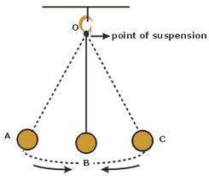
The Pendulum

Slide 3
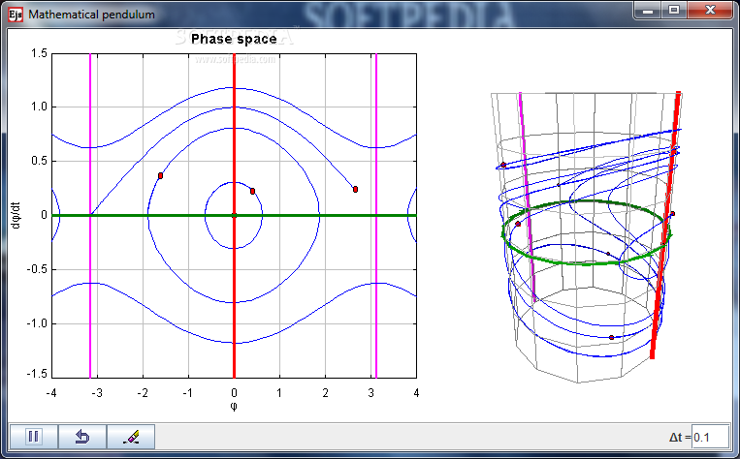
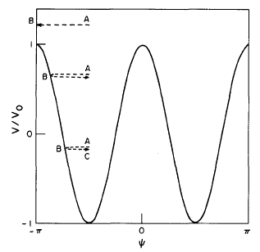
The Pendulum
A
B
C
ψ
ψ
Note the presence of two periodic orbits.
Softpedia

Slide 4


The water molecule within the Born-Oppenheimer Approximation
Normal Mode Motion

Slide 5
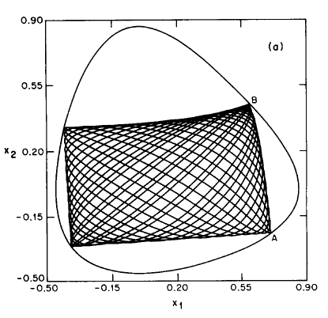
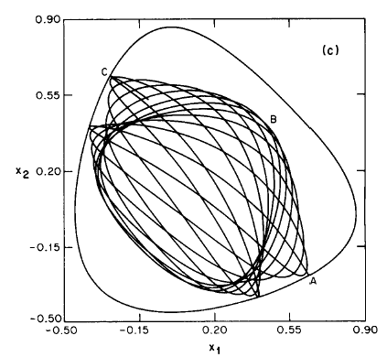
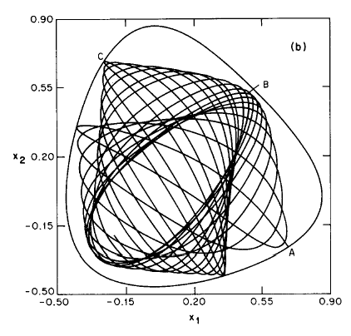
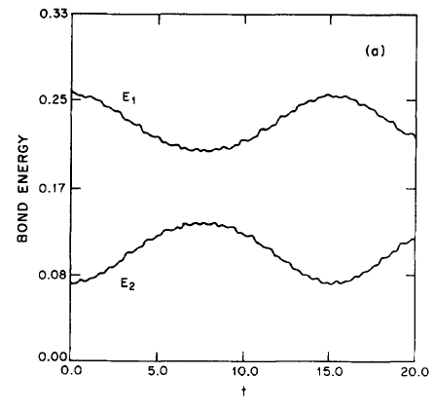
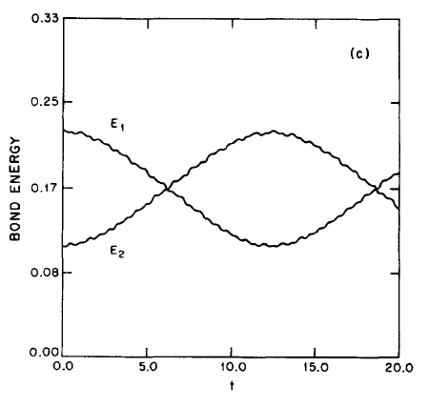
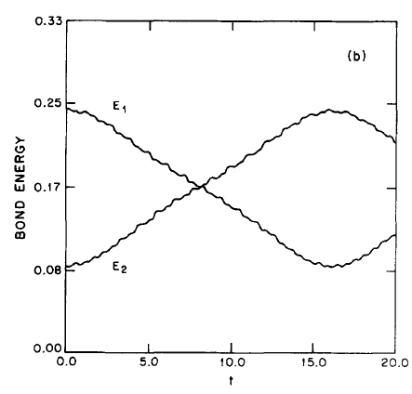
Configuration space for ABA triatomics

Slide 6
Configuration space for ABA triatomics
Map 2-D problem onto 1-D hindered rotor.
The energy difference is the momentum.
The phase difference is the angle.
ψ

Slide 7
Configuration space for ABA triatomics

Slide 8
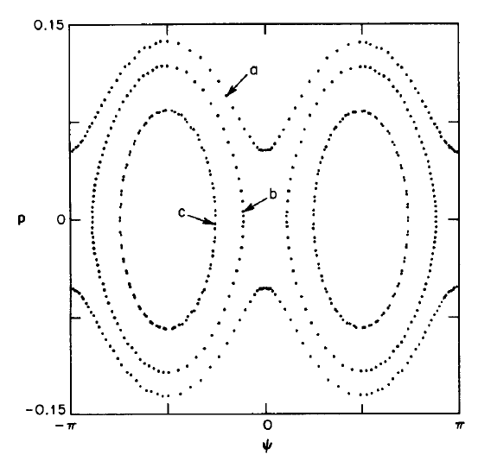
Poincare Surface of Section for Water

Slide 9
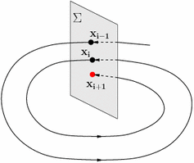
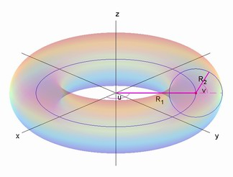
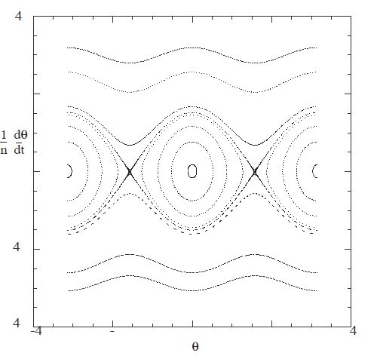
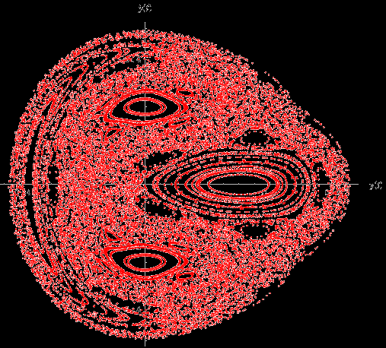

Slide 10
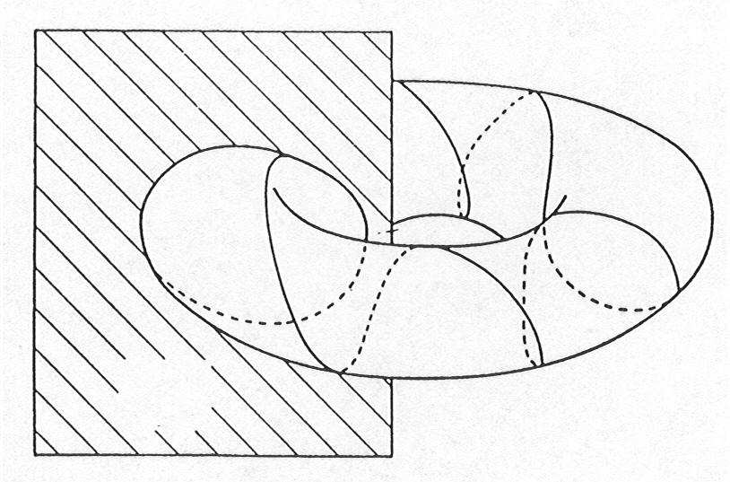
Poincare Surface of Section
From Gerhard Muller

Slide 11
Theory of the Mercury's spin-orbit motion and analysis of its main librations, N. Rambaux - E. Bois
Astronomy and Astrophysics
Abstract
The 3:2 spin-orbit resonance between the rotational and orbital motions of Mercury results from a functional dependence of the tidal friction adding to a non-zero eccentricity and a permanent asymmetry in the equatorial plane of the planet. The upcoming space missions,…

Slide 12
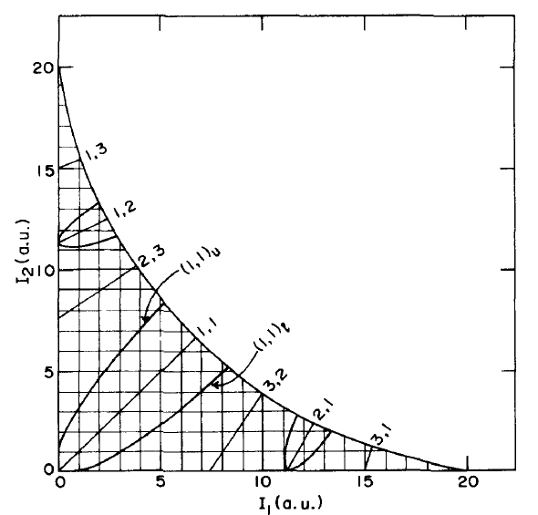
Jaffe and Brumer
and
Chirikov Theory

Slide 13
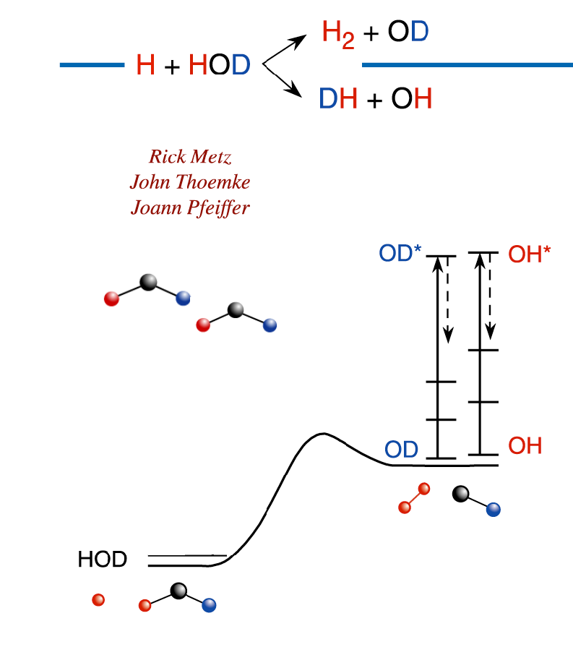

Slide 14
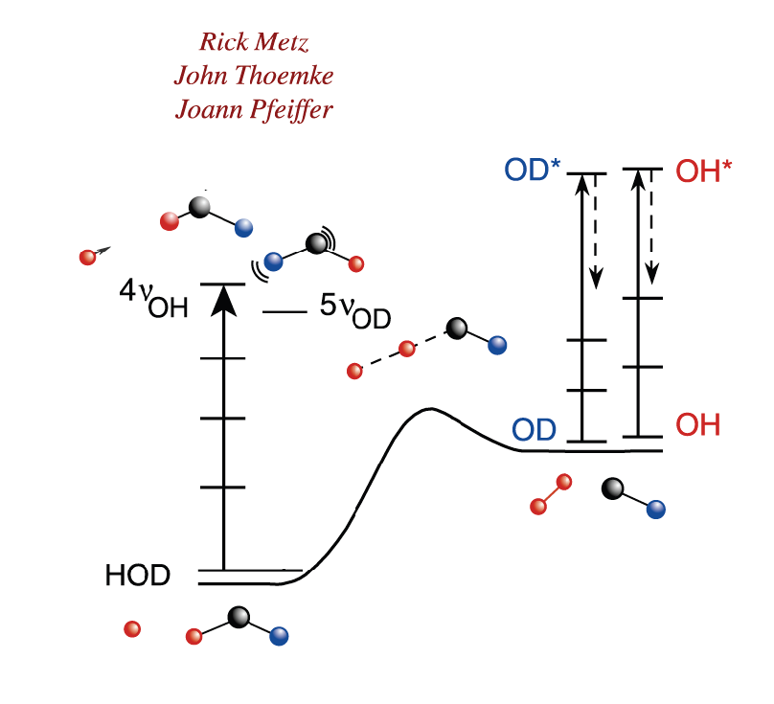

Slide 15
Periodic Orbits Appear in Both Pictures

Slide 16
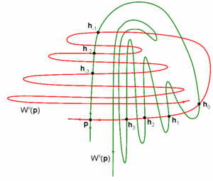
It was originally recognized by Poincaré and decades later by many founders of modern dynamical system theory that periodic orbits play an important role in understanding the rich structures in a dynamical system. Its basic properties has been briefly discussed above and for a chaotic system, the set of unstable periodic orbits can also be thought of as the skeleton for the dynamics.
Unstable periodic orbits, Paul So (2007), Scholarpedia, 2(2):1353.

Slide 17
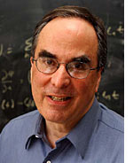
Polyatomic molecules are like balls-and springs, yet eigenstates are stationary. Where has the intricate and beautiful dance of atoms gone and how do we recover movies of intramolecular dynamics from complicated line-spectra that are recorded in the frequency-domain? Is Intramolecular Vibrational Redistribution (IVR) a code for "I really don't know what is going on" or is it an explainable, cause-and-effect mechanistic process: where does the initially localized energy flow, how fast, and why? A complete description is like a telephone directory, true but unmemorable. Mechanism is insight, even if it is neither as true nor complete as a telephone directory.

Slide 18
The Hamiltonian is
The Hamiltonian was chosen for the following reasons:
The potential is homogeneous
The dynamics is chaotic
No harmonic terms
System is free from the problems induced by (marginally stable) orbits, such as the bouncing ball or whispering gallery of Bunimovitch stadium billiard.
Wisniacki, Vergini, Benito, and Borondo, PRL 94, 054101 (2005).

Slide 19
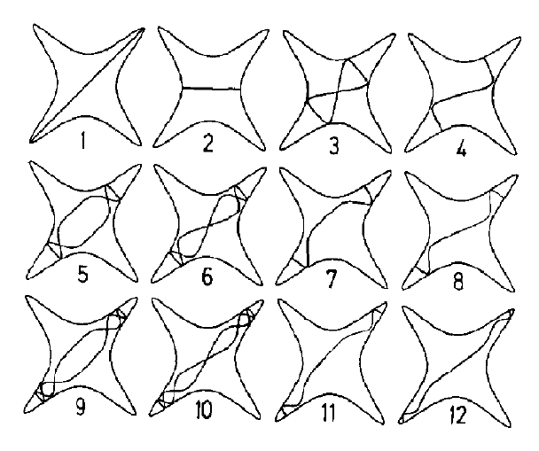
Phase space analysis of chaotic spectra in a conservative Hamiltonian system
B. Eckhardt, J. M. Gomez, and E. Pollak (CPL 1990)

Slide 20
The starting point for the analysis is a Gaussian depicted by the red circle

Slide 21
Tube Function and Husimi
x

Slide 22
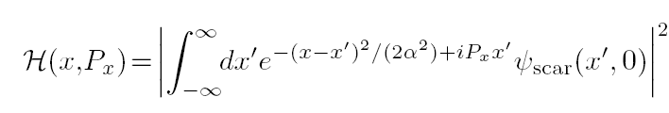
Scar Functions and Husimis
T_{E} = βΤ_{E}
Show results as a function of β.

Slide 23
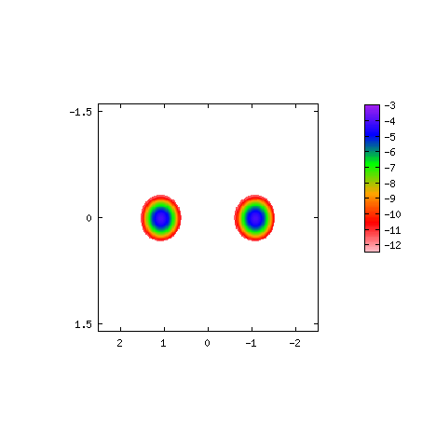

Slide 24
Are there QM interferences?

Slide 25
x
x

Slide 26
Looking for interferences

Slide 27
Dispersion
Fluctuating part (top) and its Fourier transform (bottom) of the energy dispersion. Dots corresponds to the numerical values, and the full line to a two cosine fit using the two frequencies obtained from the Fourier analysis.

Slide 28


Slide 29
Potential Energy Surfaces
Dynamics and Spectroscopy
How does one visualize and characterize the results? We do it by exploiting the correspondence principle.

Slide 30
Configuration space for ABA triatomics
Map 2-D problem onto 1-D hindered rotor.
χ

Slide 31
Schematic of Semiclassical Visualization Scheme
H_{QM}
K’_{QM}
1-D wave functions localized along χ correspond to normal mode type motion. Localization is a signature of a nonlinear resonance.
H_{CM}
K’_{CM}
This localization connects to ideas of periodic orbits.

Slide 32
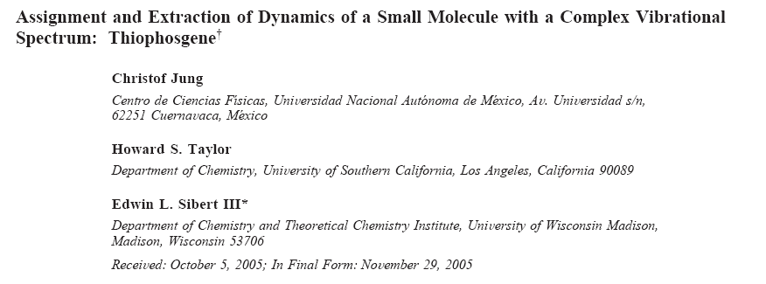
The dispersed fluoresence spectrum of the ground electronic state of SCCl₂, is analyzed in a very complex region of vibrational excitation, 7000-9000 cm-1. We assign most of the inferred excited vibrational levels in terms of approximate constants of the motion. Furthermore, each level is associated with a rung on a ladder of quantum states on the basis of common reduced dimension fundamental motions. The resulting ladders cannot be identified by any experimental means, and it is the interspersing in energy of their rungs that makes the spectrum complex even after the process of level separation into polyads.

Slide 33
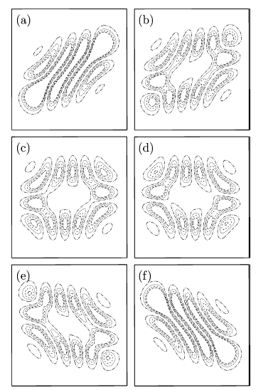
Visualizing Wave Functions
Probability distribution plotted as a function of the Q₅ and Q₆ coordinates for increasing values of Q₁ going from (a)-(f). This state is the highest energy state obtained from the K_{v} with all off-diagonal coupling set to zero except the k₁₅₆ term. The k₁₅₆ term mixes the zero-order states |5 - p, 2, 2, 0, 0 + p, 2 + p⟩ where p = 0-5.

Slide 34
For the case with all couplings are set to zero except k₁₅₆

Slide 36
Jung has sorted through the wave functions and classified most of the states as progressions built on hindered rotor like states.

Slide 37
Conclusions
The dispersed fluoresence spectrum of the ground electronic state of SCCl₂, is analyzed in a very complex region of vibrational excitation, 7000-9000 cm-1. We assign most of the inferred excited vibrational levels in terms of approximate constants of the motion. Furthermore, each level is associated with a rung on a ladder of quantum states on the basis of common reduced dimension fundamental motions. The resulting ladders cannot be identified by any experimental means, and it is the interspersing in energy of their rungs that makes the spectrum complex even after the process of level separation into polyads.

