Slide 1
Ergodicity in Chaotic Oscillators
Julien Clinton Sprott
Department of Physics
University of Wisconsin – Madison USA
Presented to the
13th IWCFTA
In Changsha, China
on
October 24, 2020

Slide 2
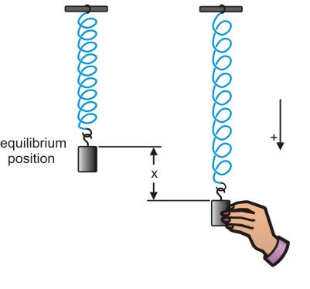
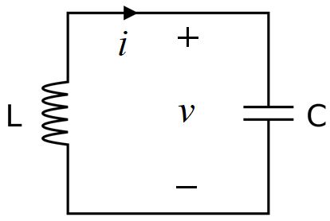
Simple Harmonic Oscillator
$$F=ma (Newton)$$
$=−$kx (Hooke)
$$x^{′}=\frac{dx}{dt}=v$$
${mv}^{′}=$ m$\frac{dv}{dt}=−$kx
$${Li}^{′}=L\frac{di}{dt}=v$$
${Cv}^{′}=$ C$\frac{dv}{dt}=−$i
$$m=k=1$$
L $=$ C $=$ $1$

Slide 3
Other Harmonic Oscillators
Pendulums
Musical Instruments
Clocks
Diatomic Molecules
Population Dynamics
Financial Market Cycles
Heartbeats …

Slide 4
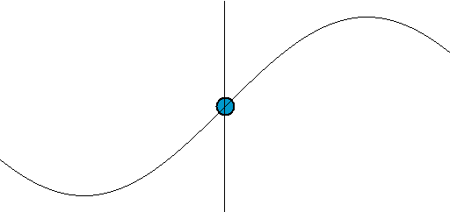
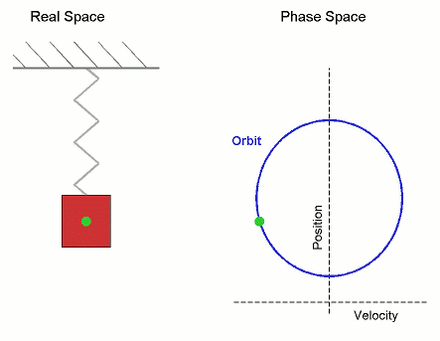
Simple Harmonic Oscillator
$$x^{′}=v$$
$v^{′}=$ $−$x
$$x=\sin{t}$$
$$v=\cos{t}$$
$x^{′′}=$ $−$x
${\text{Energy}\text{:} E=\frac{1}{2}x}^{2}+{\frac{1}{2}v}^{2}$ $=$ constant
Conservative
(Hamiltonian)
System
H = E
$x^{2}+v^{2}=2E$ (a circle in phase space)

Slide 5
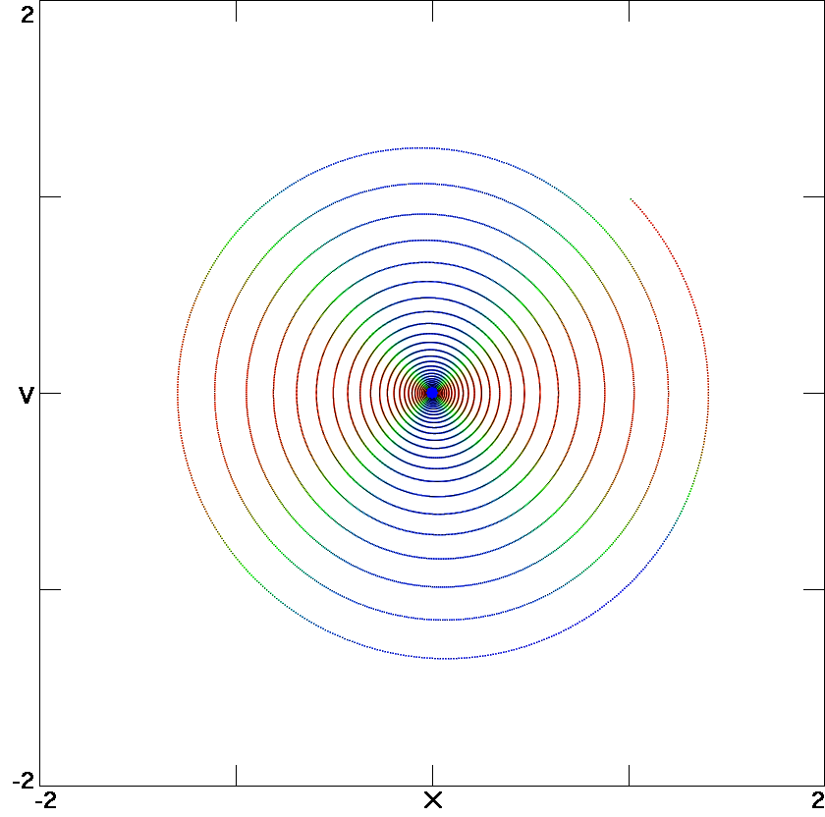
Damped Harmonic Oscillator
$$x^{′}=v$$
$v^{′}=$ $−$x $−$ b$v$
b = 0.05
bv ⇒ Linear damping
(friction or air resistance)
b is damping constant
Q = 1/b (quality factor)
Equilibrium (focus)
Point attractor
Globally attracting
Time-irreversible
Dissipative system
$r≈ e^{−bt}$^{/2}
Not true!

Slide 6
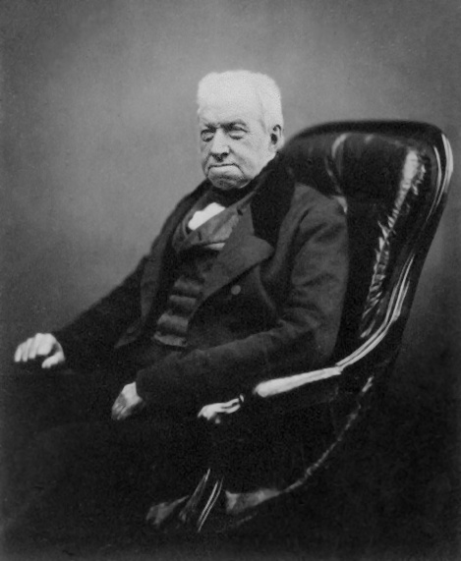
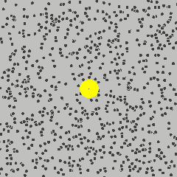
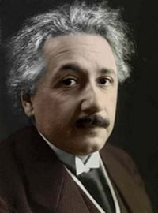
Browninan Motion
Robert Brown
Scottish botanist
(1773 – 1858)
Albert Einstein
1905
Atoms exist!

Slide 7
Ideal Gas
Every breath you take is about half a liter of air and contains about 10²² molecules
each with a mass of about 10⁻²⁵ kilograms
moving at an average speed of about 1000 meters/second (500 miles/hour)
traveling about 10⁻⁵ cm between collisions
and includes a molecule that was in the last dying breath of Julius Caesar (or Jesus or …).

Slide 8
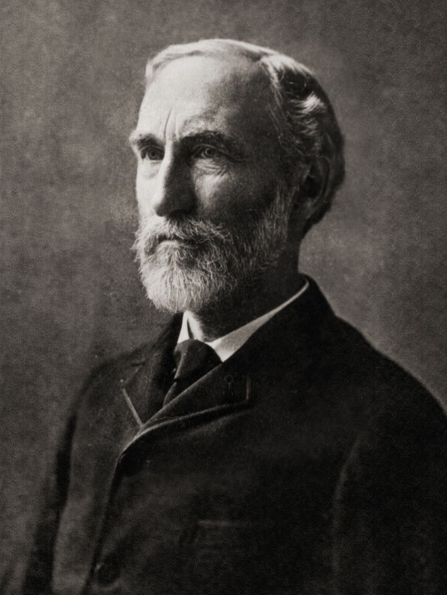
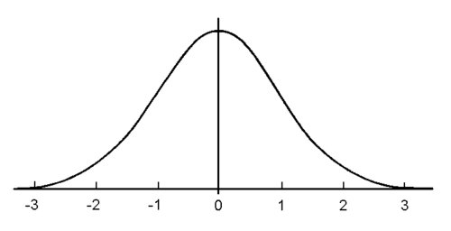
Gibbs’ Canonical Distribution
First American PhD in engineering (1863)
Professor of Mathematical Physics at Yale
Founder of statistical mechanics
Wrote famous 1902 textbook
Gaussian (normal) distribution
P_{v}$= e^{−v2/2kT}$ = $e^{−E/kT}$ (PDF)
P_{v}
“bell curve”
Josiah Willard Gibbs
American Scientist
(1839 – 1903)
$$v$$

Slide 9
Ergodicity
Time average = ensemble average
Initial conditions do not matter
Every point is phase space is visited
The simple harmonic oscillator is not ergodic

Slide 10
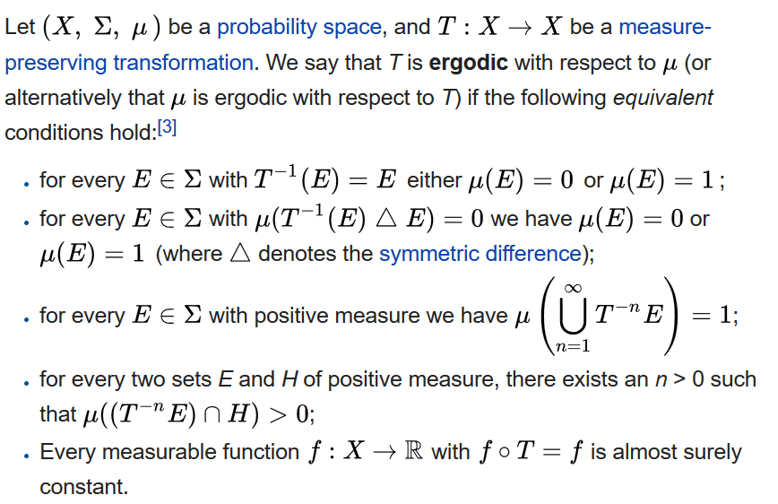
Ergodicity (formal definition)

Slide 11
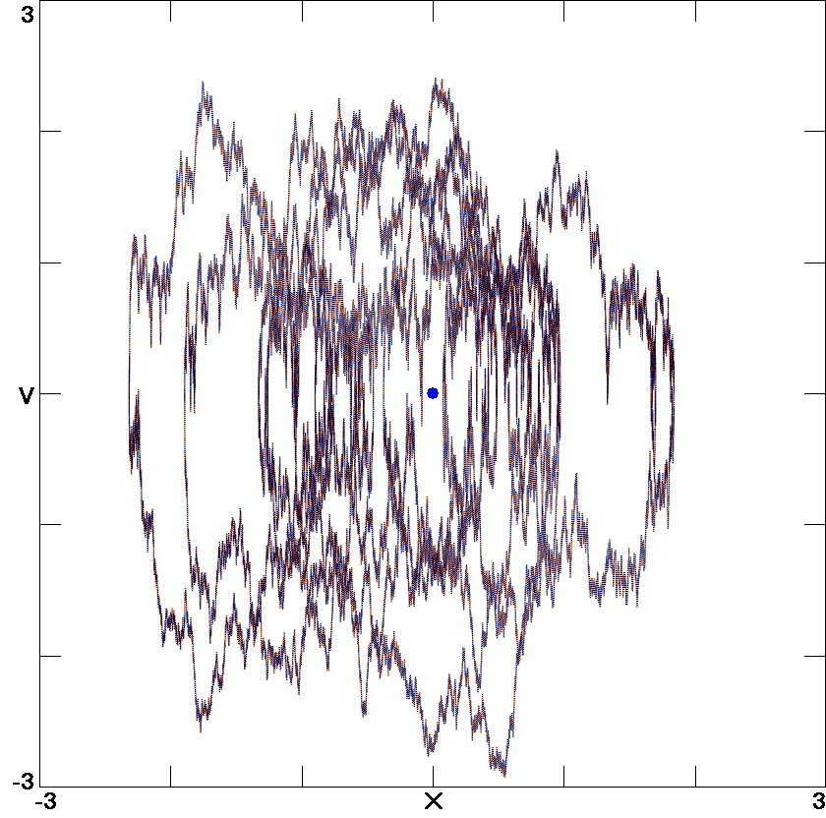
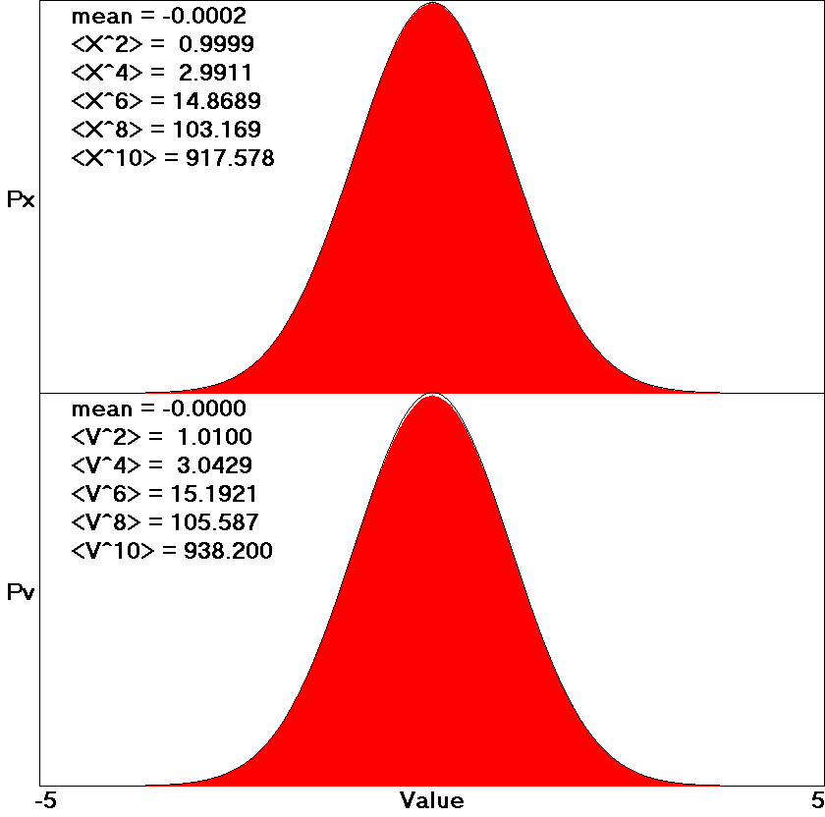
Stochastic Harmonic Oscillator
$$x^{′}=v$$
$v^{′}=$ $−$x $−$ b$v$ + F(t)
b = 1
F(t) is random forcing
Ergodic but not chaotic
(rather it is “stochastic”)

Slide 12
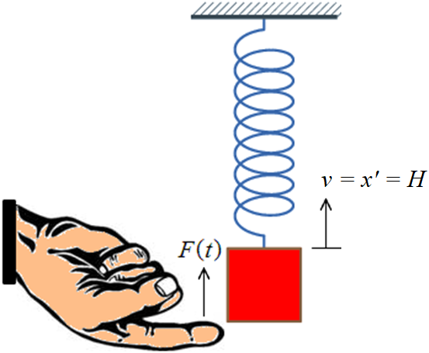
“The Finger of Fate”

Slide 13
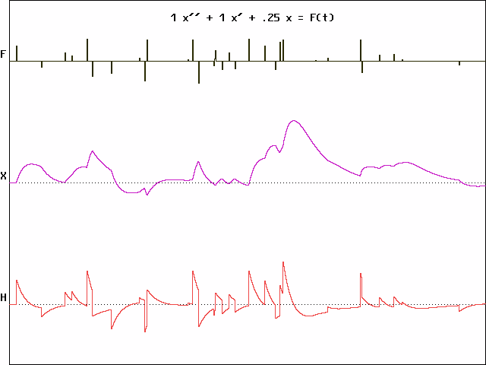
Happiness Model
x$′′$+ x$′$+ 0.25x = F(t)
Time →

Slide 14
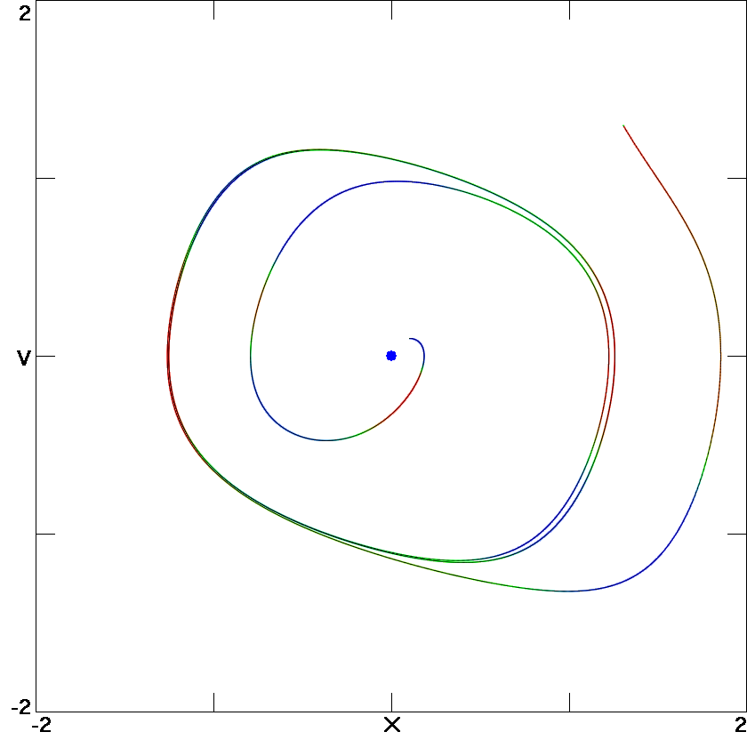
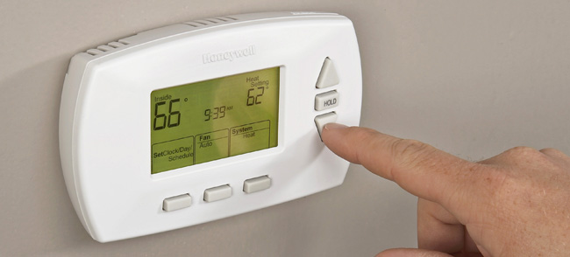
Rayleigh Oscillator
$$x^{′}=v$$
$v^{′}=$ $−$x $−$ b($v$² $−$ 1) $v$
b = 1
Nonlinear damping ($v$³)
Stable limit cycle
Periodic attractor
A feedback controller
Thermostat: <$v$²> ≈ 1
2 dimensions (x, $v$) ⇒ no chaos
(Poincaré-Bendixson theorem)

Slide 15
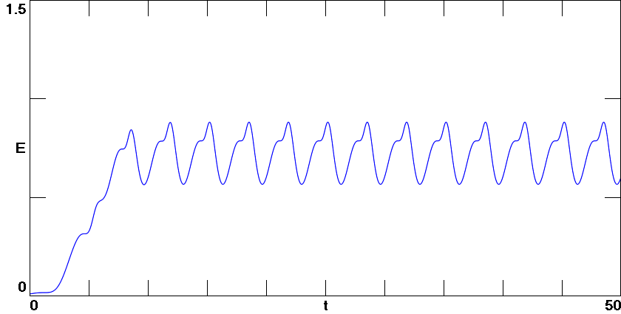
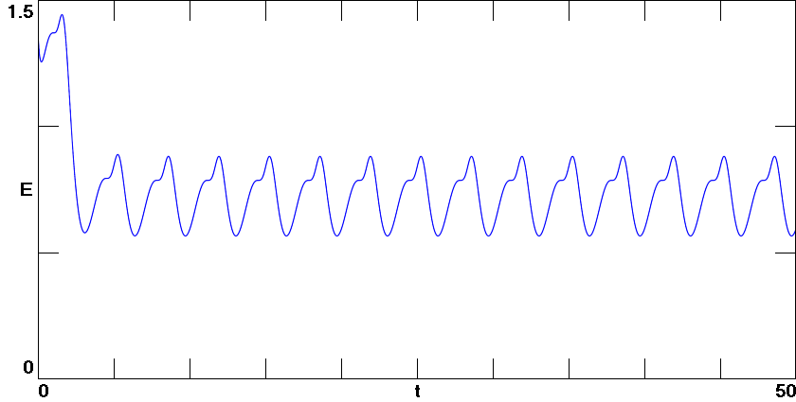
Energy vs Time
cold start
hot start

Slide 16
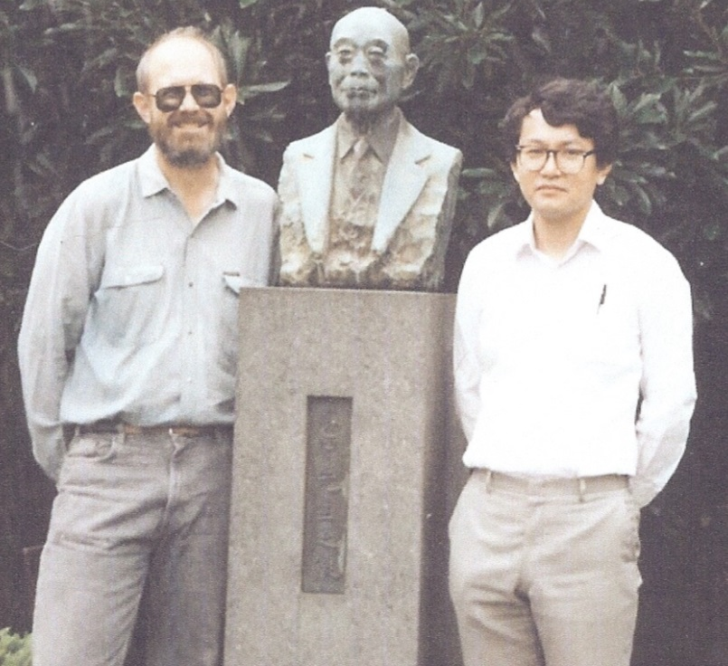
Nosé-Hoover Oscillator
$$x^{′}=v$$
$v^{′}=$ $−$x $−$ z$v$
$$z^{′}=v2 −T$$
Thermostat: <$v$²> = T
Isothermal vs isoenergetic
Chaotic solutions
Also called “Sprott A” system
Simplest such chaotic system
Many interesting properties
Bill Hoover & Shuichi Nosé (1989)

Slide 17
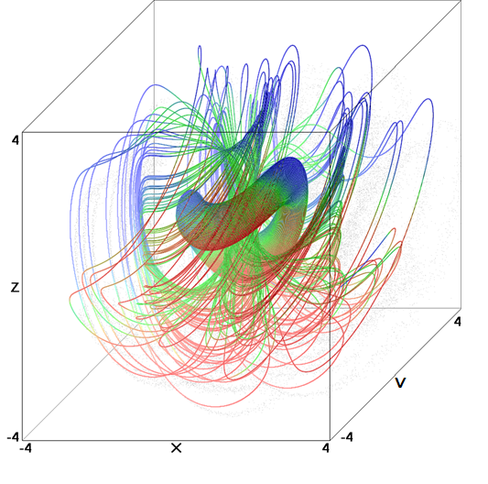
Nosé-Hoover Oscillator (cont)
$$x^{′}=v$$
$v^{′}=$ $−$x $−$ z$v$
$$z^{′}=v2 −T$$
T = 1
Coexisting quasiperiodic tori and chaotic sea
Nonuniformly conservative <z> $=$ 0
Lyapunov exponents:
(0, 0, 0) for tori
(0.0139, 0, $−$0.0139)
for chaotic sea
No equilibrium points

Slide 18
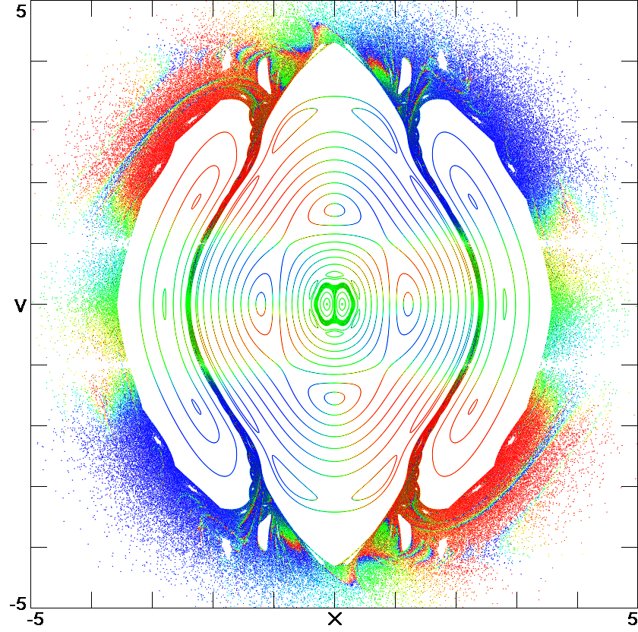
Nosé-Hoover Oscillator (cont)
$$x^{′}=v$$
$v^{′}=$ $−$x $−$ z$v$
$$z^{′}=v2 −T$$
T = 1
z = 0
Fat fractal (many “holes”)
Non-Gaussian
Time-reversible
Only 6% chaotic
Not ergodic

Slide 19
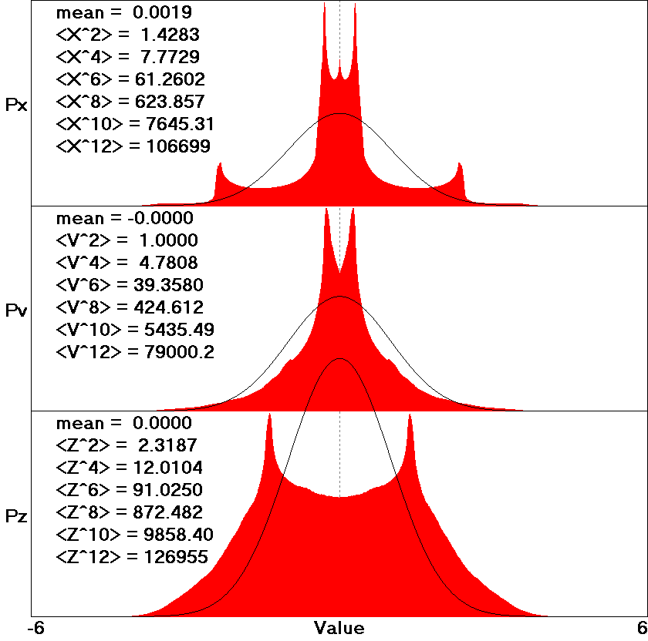
Nosé-Hoover Oscillator (cont)

Slide 20
Ergodic Thermostats
$$x^{′}=v$$
$v^{′}=$ $−$x $−$ y$v$
$$y^{′}=v2−T −zy$$
$$z^{′}=y2−T$$
$$x^{′}=v$$
$v^{′}=$ $−$x $−$ (0.05 + 0.32v²)z$v$
$z^{′}=0.05(v2−$ T) + 0.32($v$⁴ – 3$v$²)
$$x^{′}=v$$
$v^{′}=$ $−$x $−$ 10T tanh(20z) $v$
$$z^{′}=v2−T$$

Slide 21
Signum Thermostat
$$x^{′}=v$$
$v^{′}=$ $−$x $−$ z$v$
$$z^{′}=v2 −T$$
Proportional
controller
Nose-Hoover:
$$x^{′}=v$$
$v^{′}=$ $−$x $−$ a sgn(z) 𝑣
$$z^{′}=v2 −T$$
Signum thermostat:
Bang-bang
controller
{
$−$1 for z < 0
+1 for z > 0
Signum function:
sgn(z) =

Slide 22
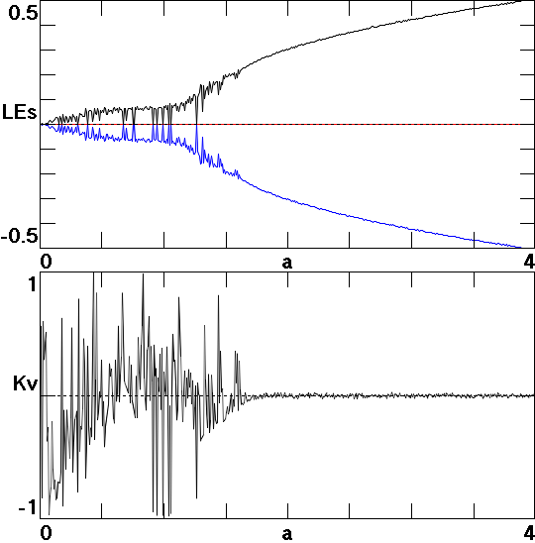
A Single Parameter
Ergodic for a > 1.8

Slide 23
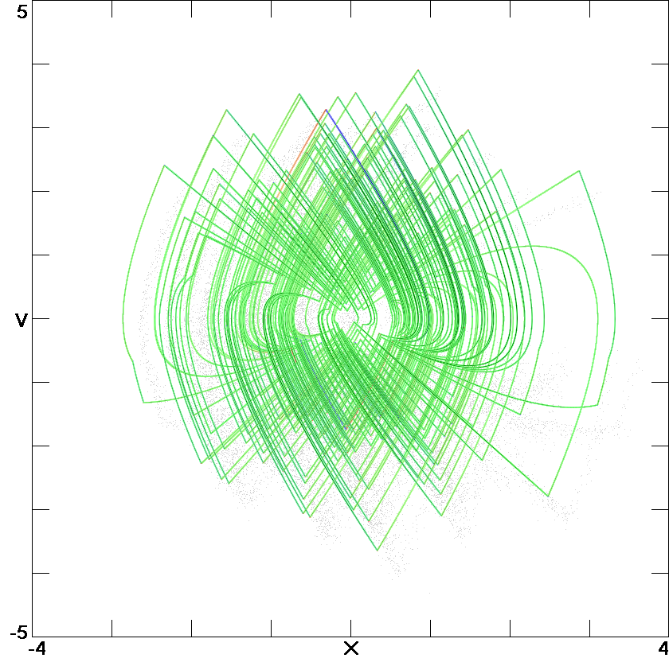
Yes, it is Chaotic
a = 2
T = 1

Slide 24
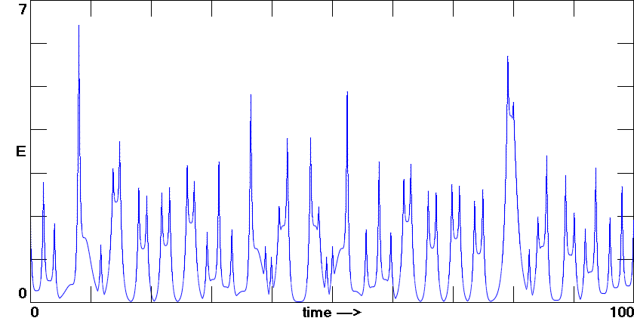
Yes, it is Isothermal
a = 2
T = 1

Slide 25
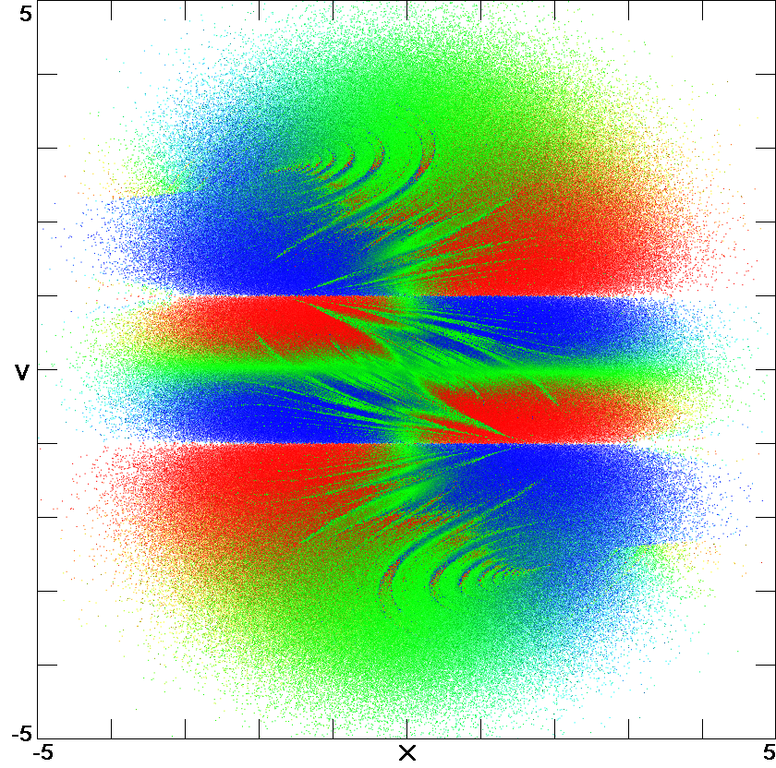
Yes, it is Ergodic
a = 2
T = 1
z = 0

Slide 26
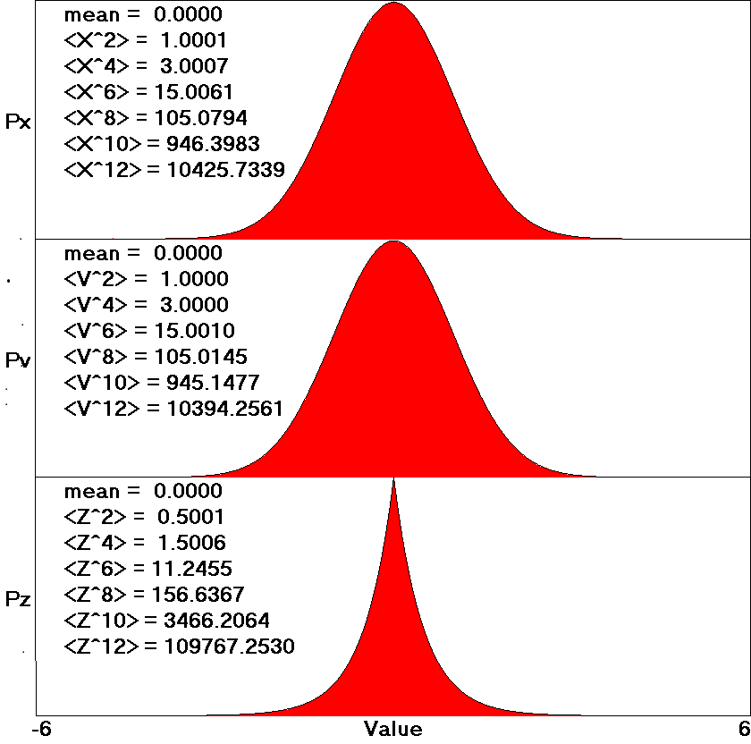
Yes, it is Gaussian
a = 2
T = 1
Px = exp(-x²/2)
Pv = exp(-v²/2)
Pz = exp(-2|z|)

Slide 27
The Signum Thermostat
Is mathematically elegant.
Has only a single parameter.
Works for a wide variety of oscillators.
Invites analytic analysis and proofs.
$${ x}^{′}=v$$
${ v}^{′}=$ $−$x $−$ 2$v$ sgn z
$${ \text{z}}^{′}=v2 −1$$

Slide 28
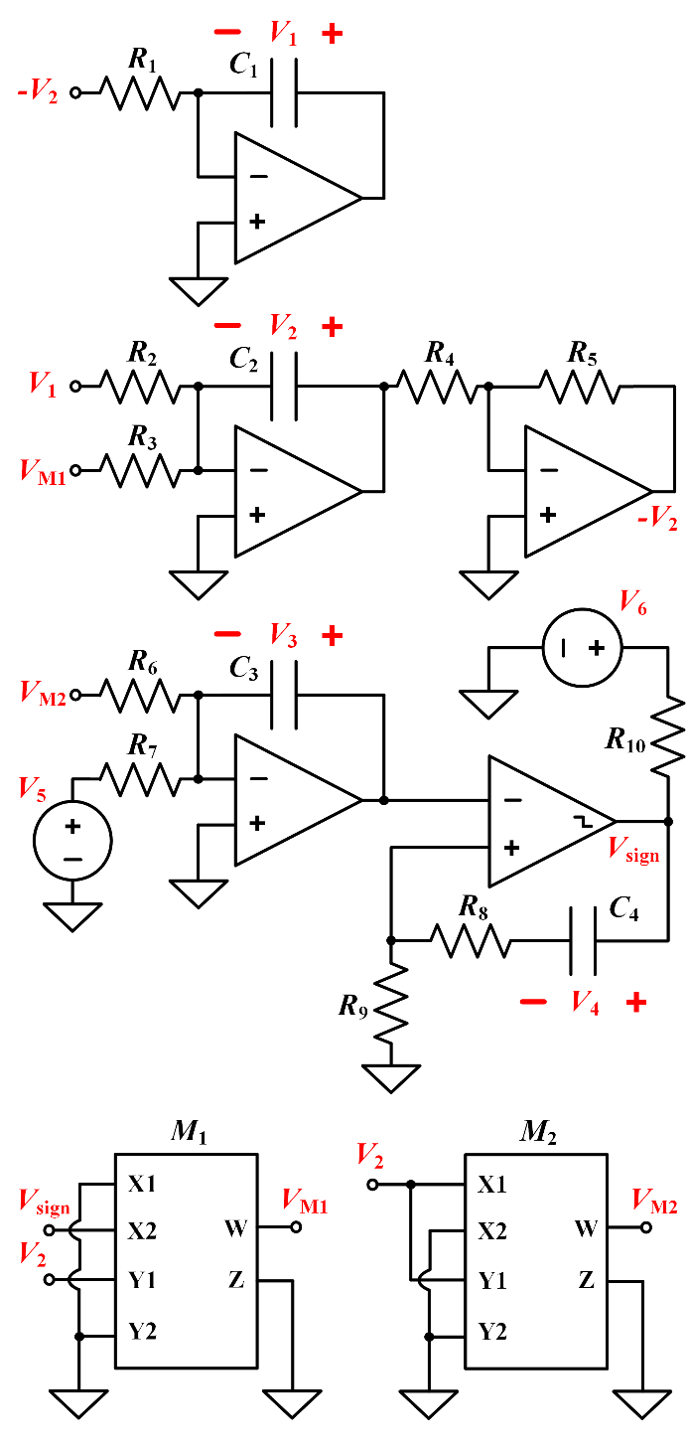
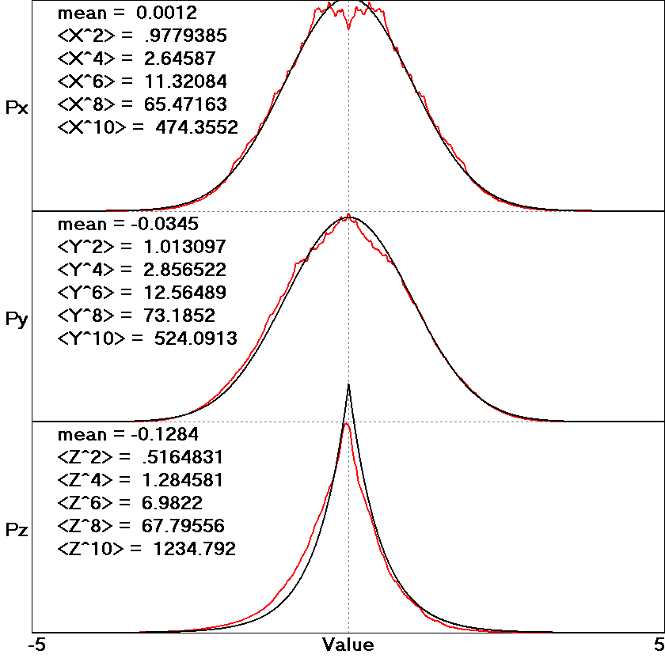
Electronic Gaussian RNG

Slide 29
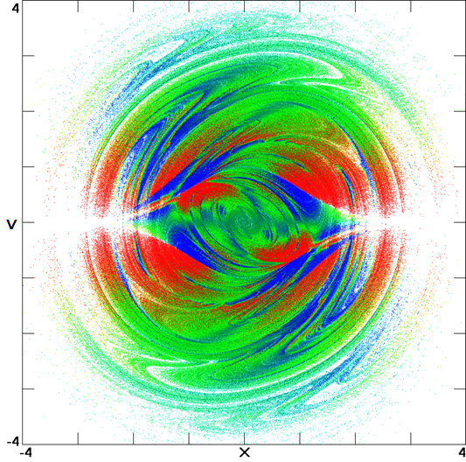
Strange Strange Attractor
$$x^{′}=v$$
$v^{′}=$ $−$x $−$ a sgn(z)$v$
$$z^{′}=v2 −T(x)$$
a = 1 T(x) = exp($−$x²)
z = 0
Thermostatted oscillator with a temperature gradient
Dissipative: <z> $>$ 0
No equilibrium points
==> Hidden attractor
Lyapunov exponents:
(0.2280, 0, $−$0.2480)
D_{KY} = 2.9194
D₀ = 3.0

Slide 30
Summary
The harmonic oscillator is the oldest and most important dynamical system.
With a signum thermostat, it can be made to replicate a truly random system.
The system is ripe for further analysis and study.

Slide 31
References
http://sprott.physics.wisc.edu/ lectures/ergodic.pptx (this talk)
http://sprott.physics.wisc.edu/pubs/paper499.pdf (signum thermostat)
sprott@physics.wisc.edu (contact me)

