Slide 1
Workshop on Chaos, Fractals, and Power Laws
Clint Sprott (workshop leader)
Department of Physics
University of Wisconsin - Madison
Presented at the Annual Meeting of the
Society for Chaos Theory in Psychology and Life Sciences
at Marquette University
in Milwaukee, WI
on July 31, 2014
Notes:
Entire presentation available on WWW

Slide 2
Introductions
Name?
Affiliation?
Field?
Level of expertise?
Main interest?
  Chaos
  Fractals
  Power laws

Slide 3
Connections
Chaos
Fractals
Power Laws
Chaos makes fractals
Fractals are the “fingerprints of chaos”
Fractals obey power laws
The power is the dimension of the fractal

Slide 4
Dynamical Systems
Dynamical Systems
Deterministic
Linear
Nonlinear
Stochastic
(Random)
Periodic
Quasiperiodic
Chaotic
Transient

Slide 5
Chaos
Sensitive dependence on initial conditions
Topologically mixing
Dense periodic orbits

Slide 6
Heirarchy of Dynamical Behaviors
Regular predictable (clocks, planets, tides)
Regular unpredictable (coin toss)
Transient chaos (pinball machine)
Intermittent chaos (logistic map, A = 3.83)
Narrow band chaos (Rössler system)
Broad-band low-D chaos (Lorenz system)
Broad-band high-D chaos (ANNs)
Correlated (colored) noise (random walk)
Pseudo-randomness (computer RNG)
Random noise (radioactivity, radio ‘static’)
Combination of the above (most real-world phenomena)

Slide 7
Chaotic Systems
Discrete-time (iterated maps) / continuous time (ODEs)
Conservative / dissipative
Autonomous / non-autonomous
Chaotic / hyperchaotic
Regular / spatiotemporal chaos (cellular automata, PDEs)

Slide 8
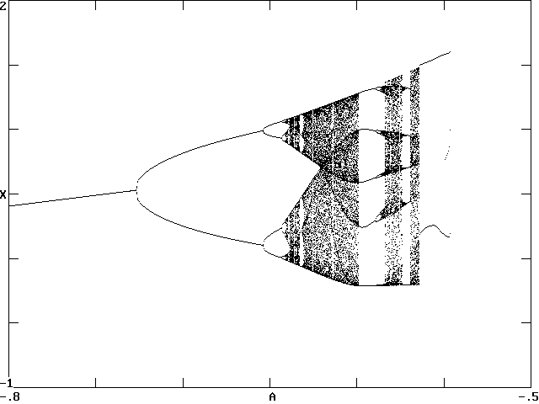

Bifurcation Diagram for Chaotic Circuit

Slide 9

Stretching and Folding
Notes:
This models a driven pendulum with friction
Looks like those taffy machines at the fair
Show silly putty

Slide 10
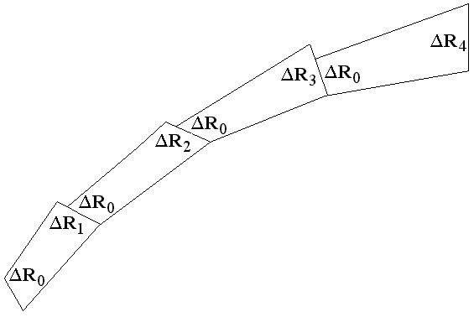
Lyapunov Exponents
λ₁ = <log(ΔR_{n}/ΔR₀)> / Δt
Notes:
This models a driven pendulum with friction
Looks like those taffy machines at the fair
Show silly putty

Slide 11
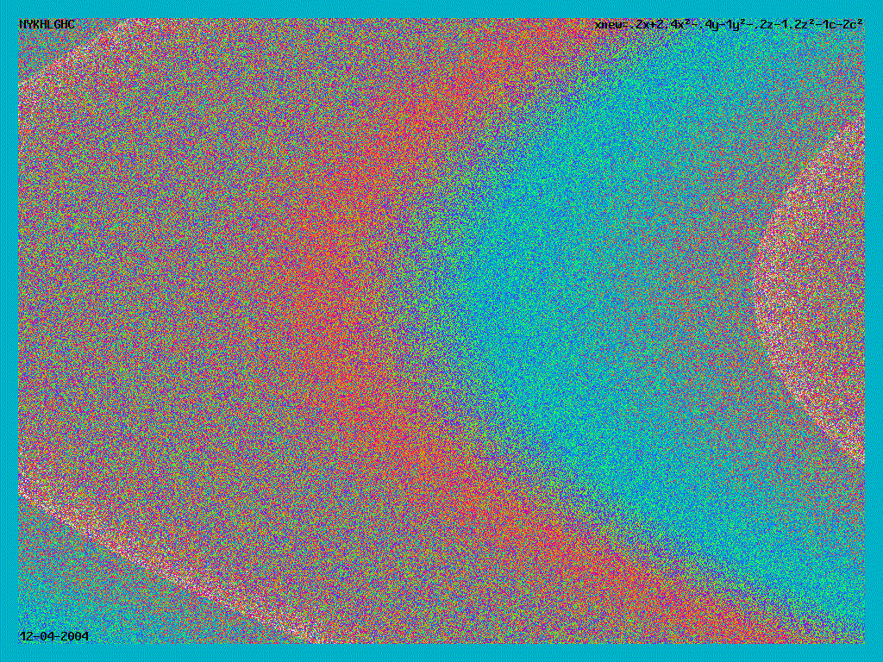

Slide 12
Other Chaos Topics
Limit cycles
Quasiperiodicity and tori
Poincaré sections
Transient chaos
Intermittency
Basins of attraction
Bifurcations
Routes to chaos
Hidden attractors

Slide 13
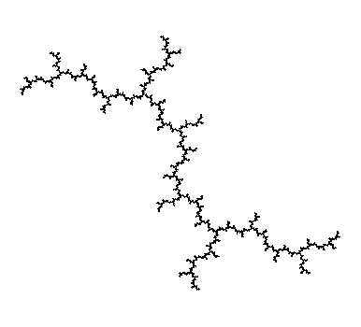

Fractals
Geometrical objects generally with non-integer dimension
Self-similarity (contains infinite copies of itself)
Structure on all scales (detail persists when zoomed arbitrarily)
Notes:
These are deterministic fractals
Many are precisely self-similar
Produced by simple formulas

Slide 14
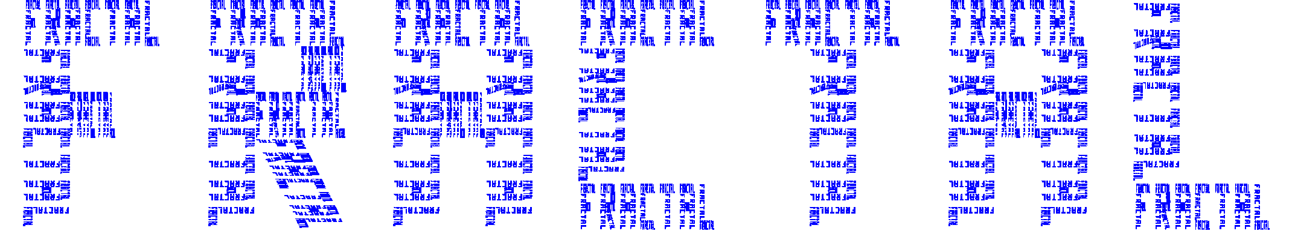
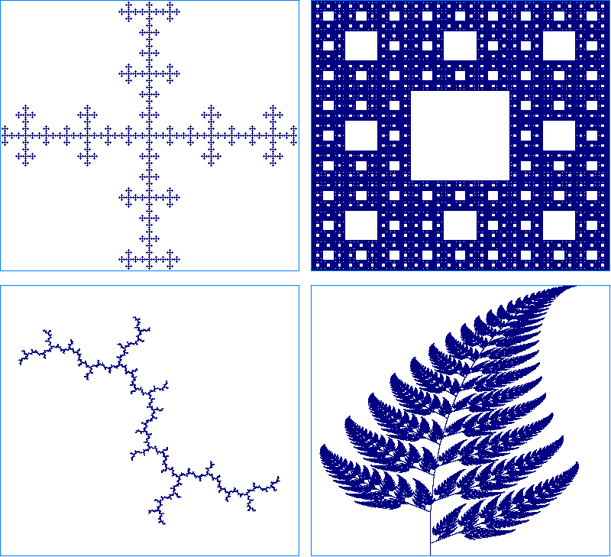
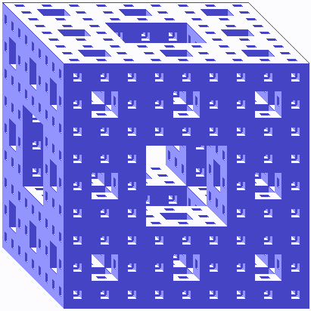

Slide 15
Fractal Types
Deterministic / random
Exact self-similarity / statistical self-similarity
Self-similar / self-affine
Fractal / prefractal
Mathematical / natural

Slide 16
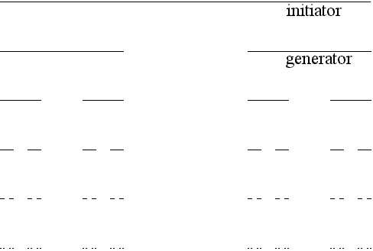
Cantor Set
D = log 2 / log 3 = 0.6309…

Slide 17
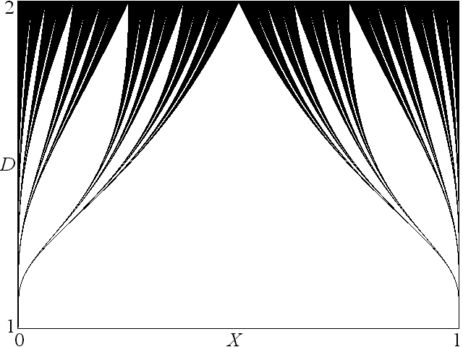
Cantor Curtains

Slide 18
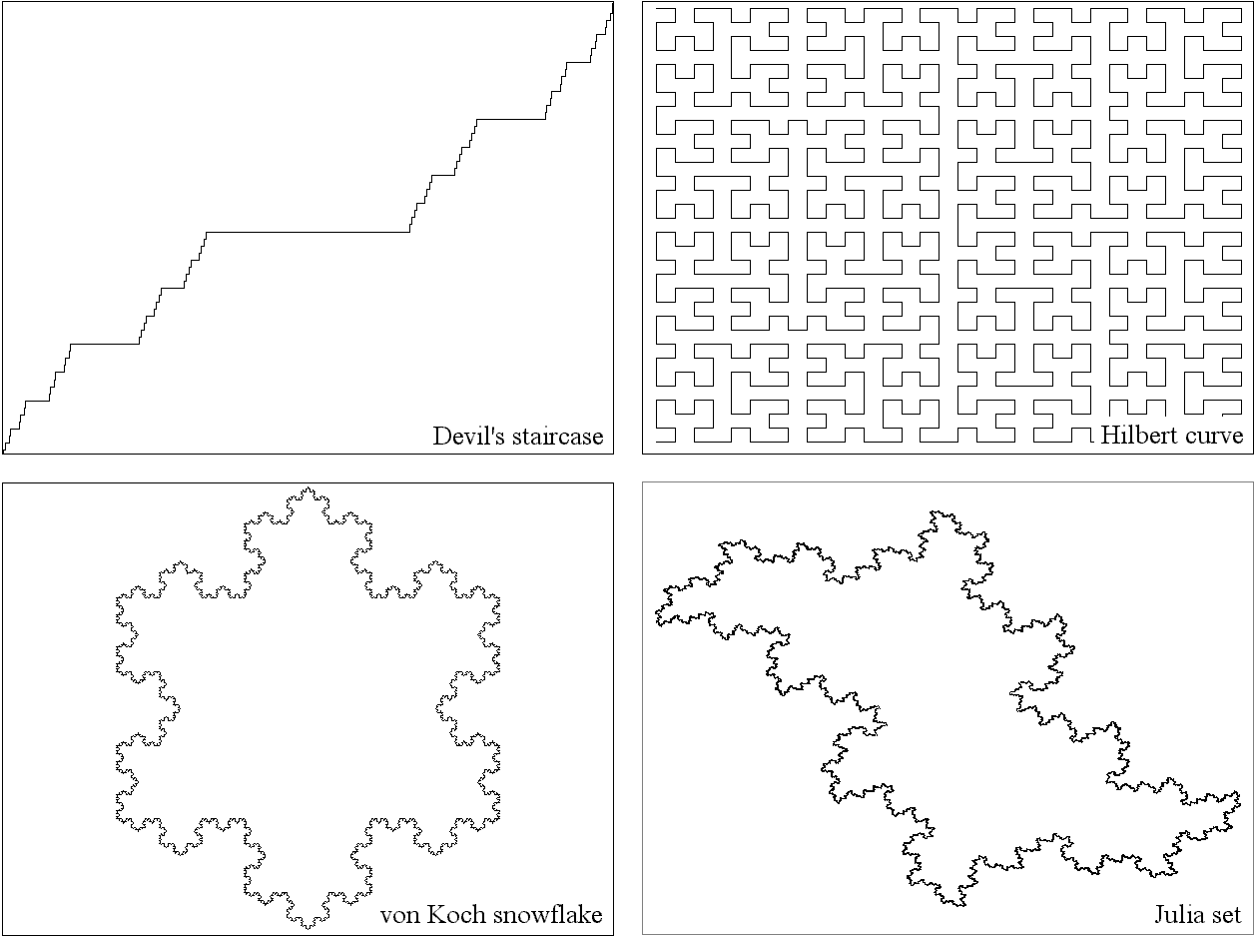
Fractal Curves

Slide 19
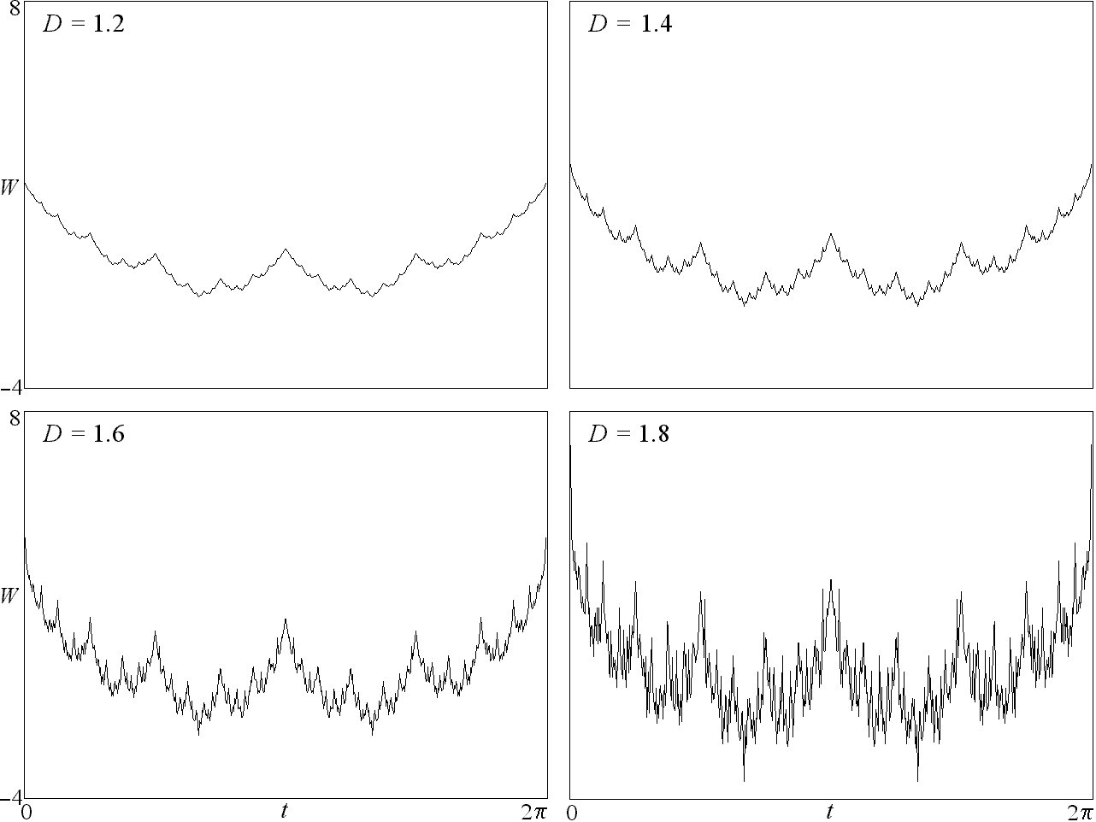

Weisstrass Function

Slide 20
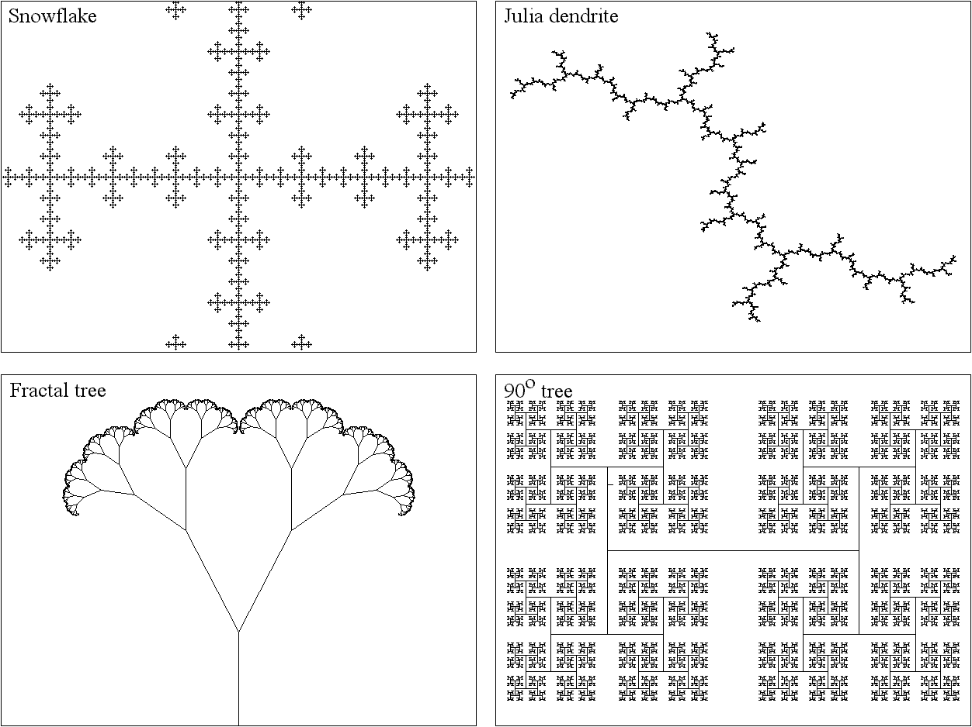
Fractal Trees

Slide 21
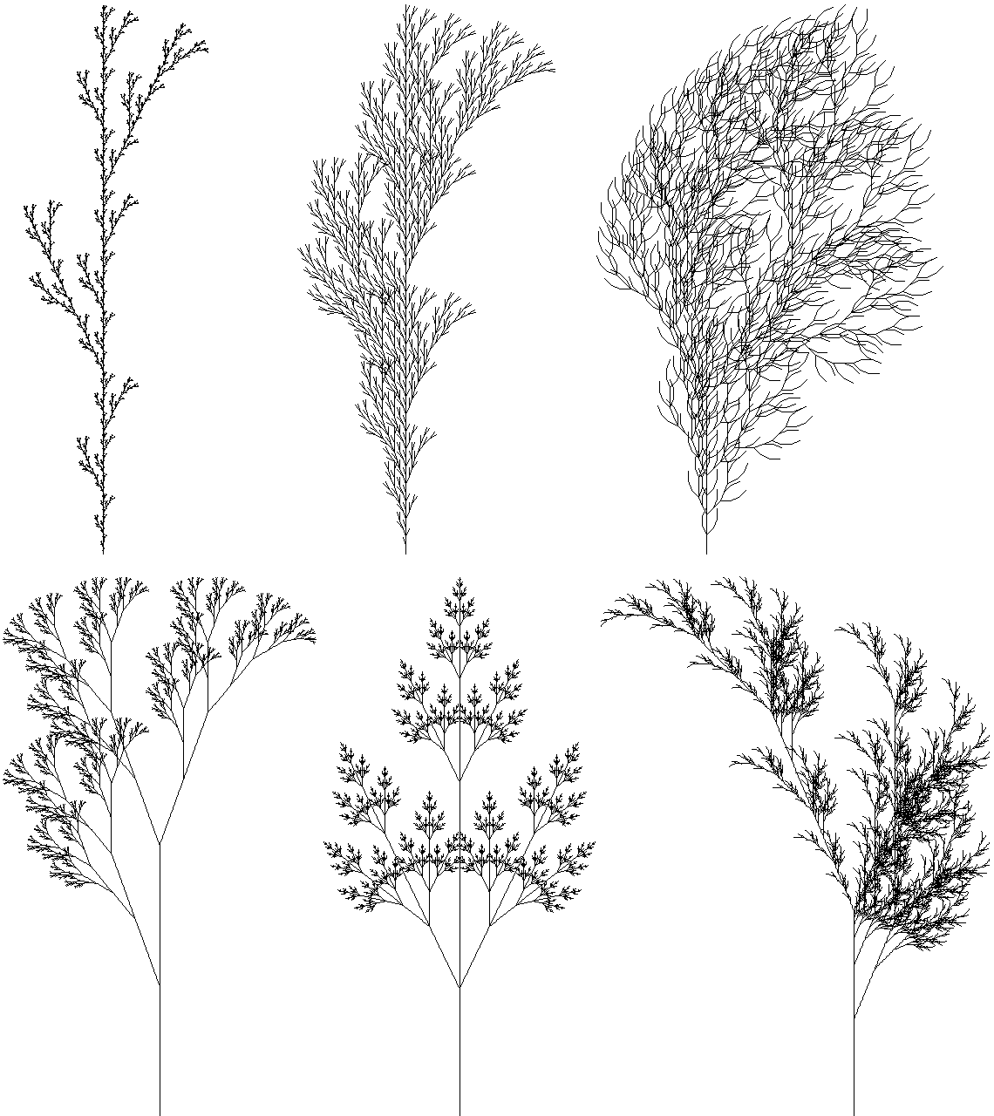
Lindenmayer Systems

Slide 22
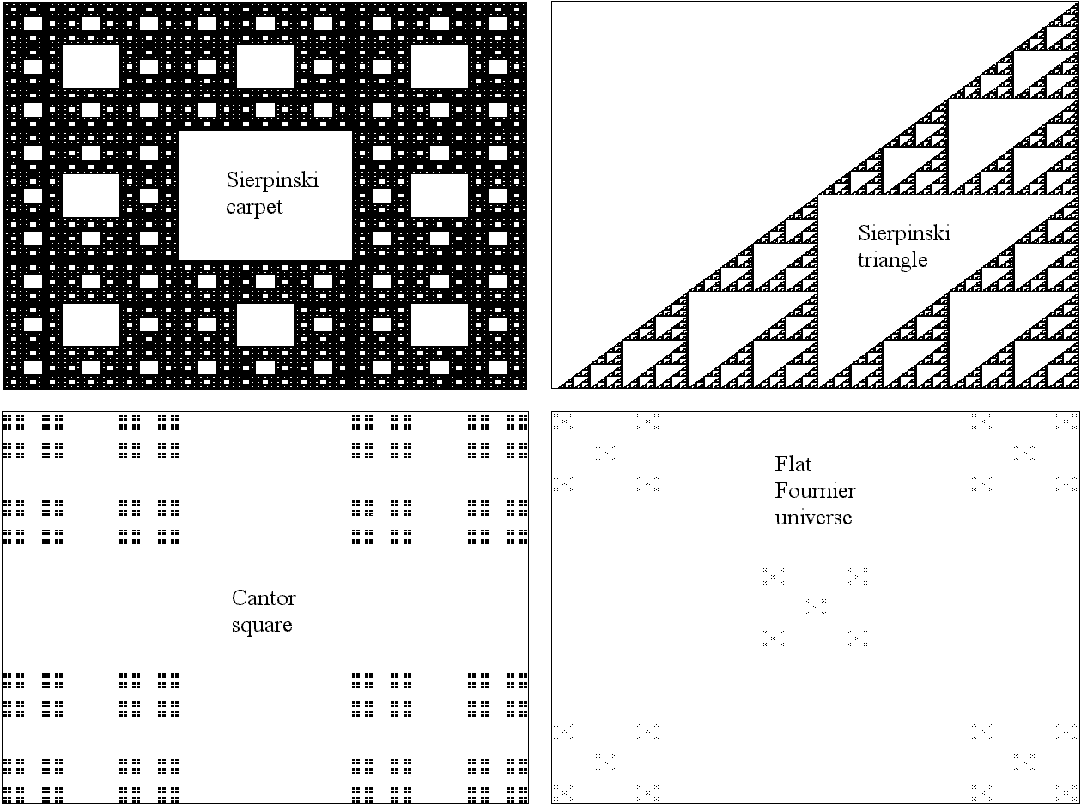
Fractal Gaskets

Slide 23
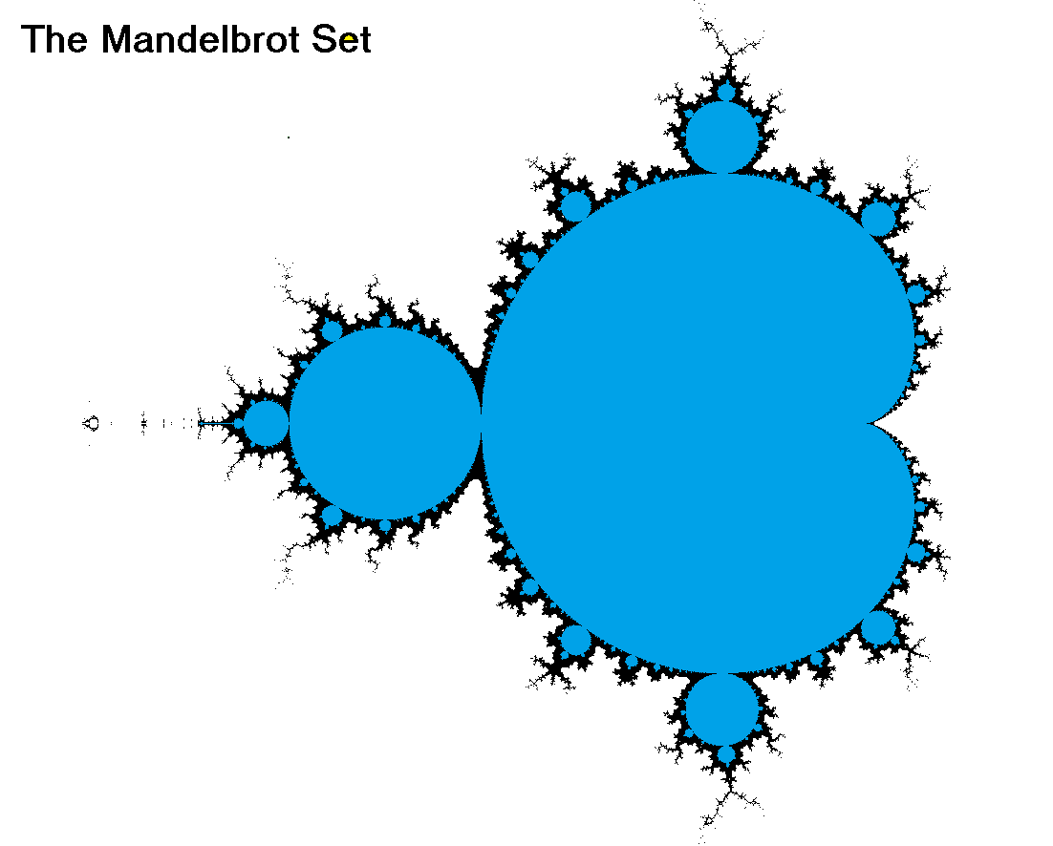

Slide 24
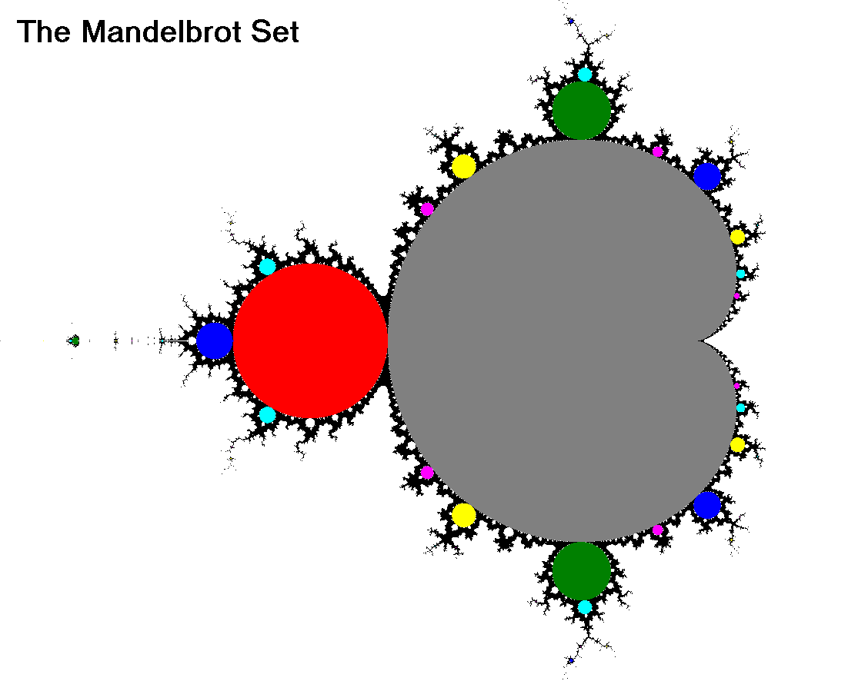

Slide 25
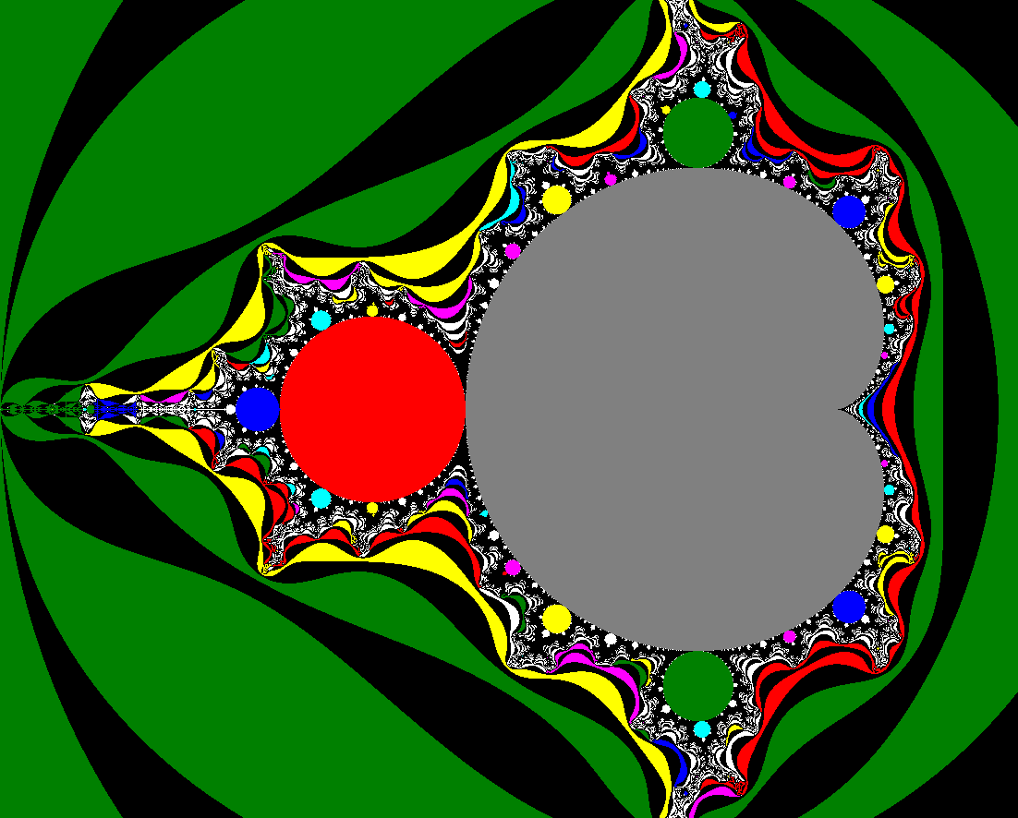

Slide 26
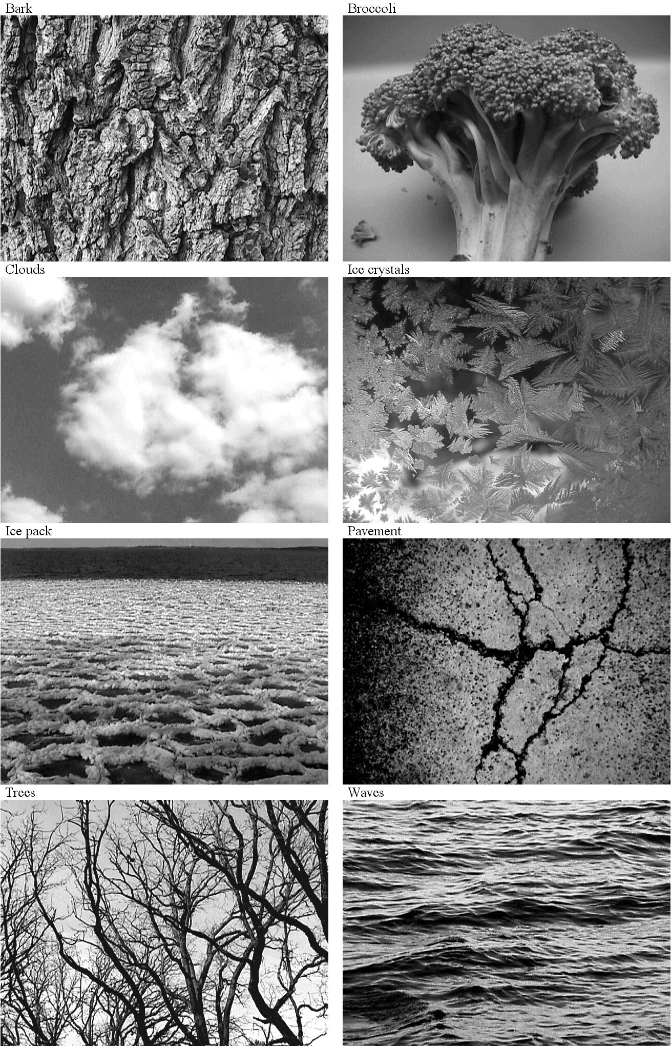
Natural Fractals

Slide 27
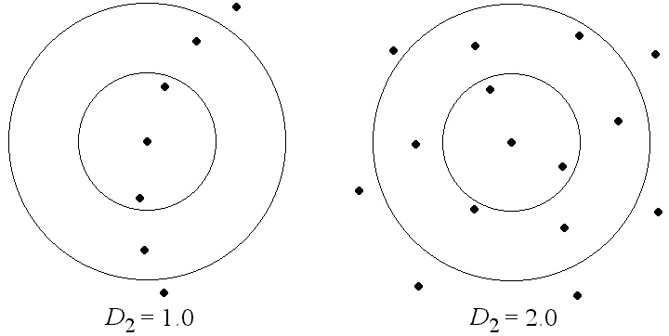
Fractal Dimension

Slide 28
Other Fractal Topics
Julia sets
Diffusion-limited aggregation
Fractal landscapes
Multifractals
Rényi (generalized) dimensions
Iterated function systems
Cellular automata
Lindenmayer systems

Slide 29
Power Laws
y = x^{α}
log y = α log x
α is the slope of the curve log y versus log x
Note that the integral of y from zero to infinity is infinite (not normalizable)
Thus no probability distribution can be a true power law

Slide 30
Other Properties
No mean or standard deviation
Scale invariant
“Fat tail”

Slide 31
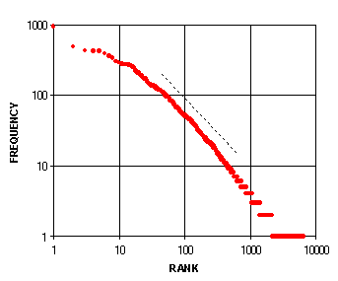
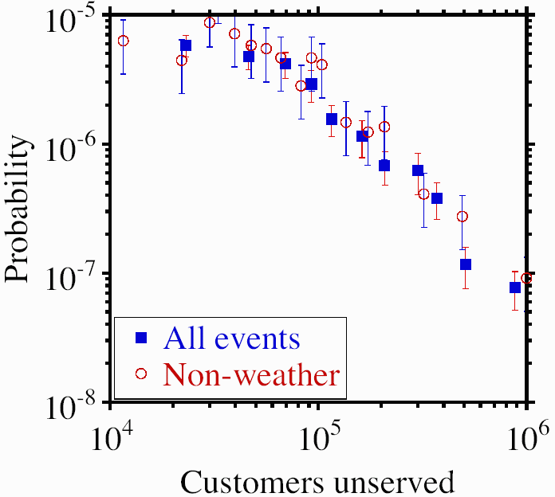
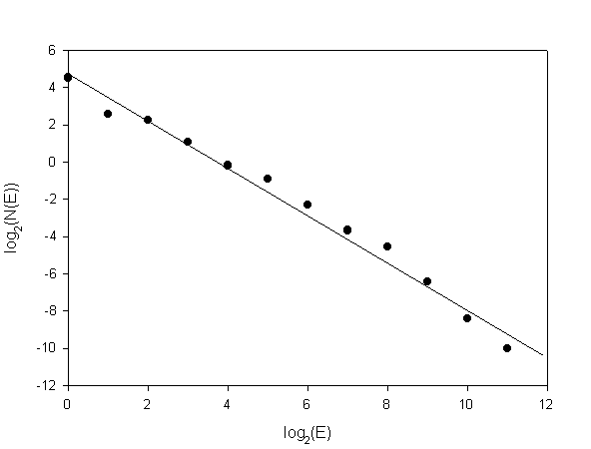
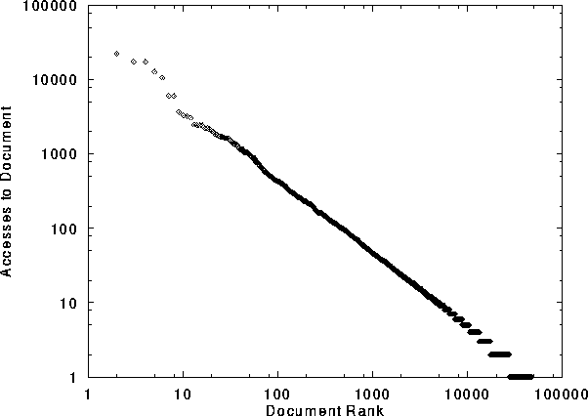
Power Laws (Zipf)
Words in English Text
Size of Power Outages
Earthquake Magnitudes
Internet Document Accesses

Slide 32
Other Examples of Power Laws
Populations of cities
Size of moon craters
Size of solar flares
Size of computer files
Casualties in wars
Occurrence of personal names
Number of papers scientists write
Number of citations received
Sales of books, music, …
Individual wealth, personal income
Many others …

Slide 33
References
http://sprott.physics.wisc.edu/ lectures/sctpls14.pptx (this talk)
http://sprott.physics.wisc.edu/chaostsa/ (my chaos textbook)
sprott@physics.wisc.edu (contact me)

Slide 34
Props
String
Silly putty
Menger sponge
Sheet of paper
Rubber ball
2 copies of CTSA
3 copies of ICW
Coin to toss
Chaotic circuit / speaker
Driven chaotic pendulum

