Slide 1
Welcome to the Wonders of Physics 2016!

Slide 2
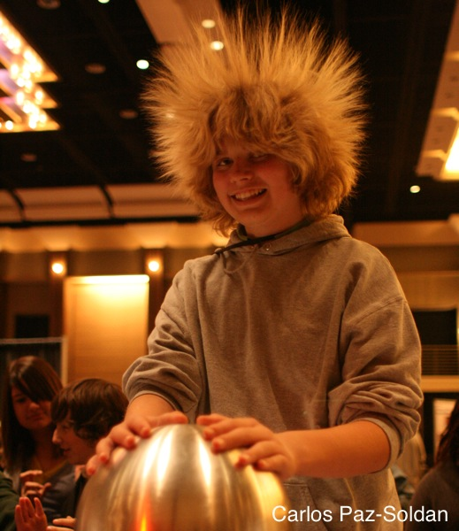
The Wonders of Physics Traveling Show can visit your school!
Thousands of traveling shows have been presented to 100,000+ students in Wisconsin and 36 other states
The Wonders of Physics shows make a great science assembly program for school groups of all grade levels
Visit our website for more info:
http://wonders.physics.wisc.edu

Slide 3
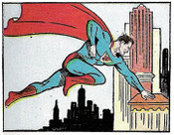
Gravity: Earth vs. Krypton
According to Action Comics #1 (June 1938), Superman’s could jump one eighth of a mile, or 660 ft., on Earth.
THEORY: Superman’s home world,
Krypton, had very strong gravity.
Normal strength on Krypton = super strength on Earth.
QUESTION: for Superman to jump 660 ft., how many times stronger would Krypton’s gravity be than Earth’s?
A) 5x B) 10x C) 15x D) 30x E) 100x

Slide 4
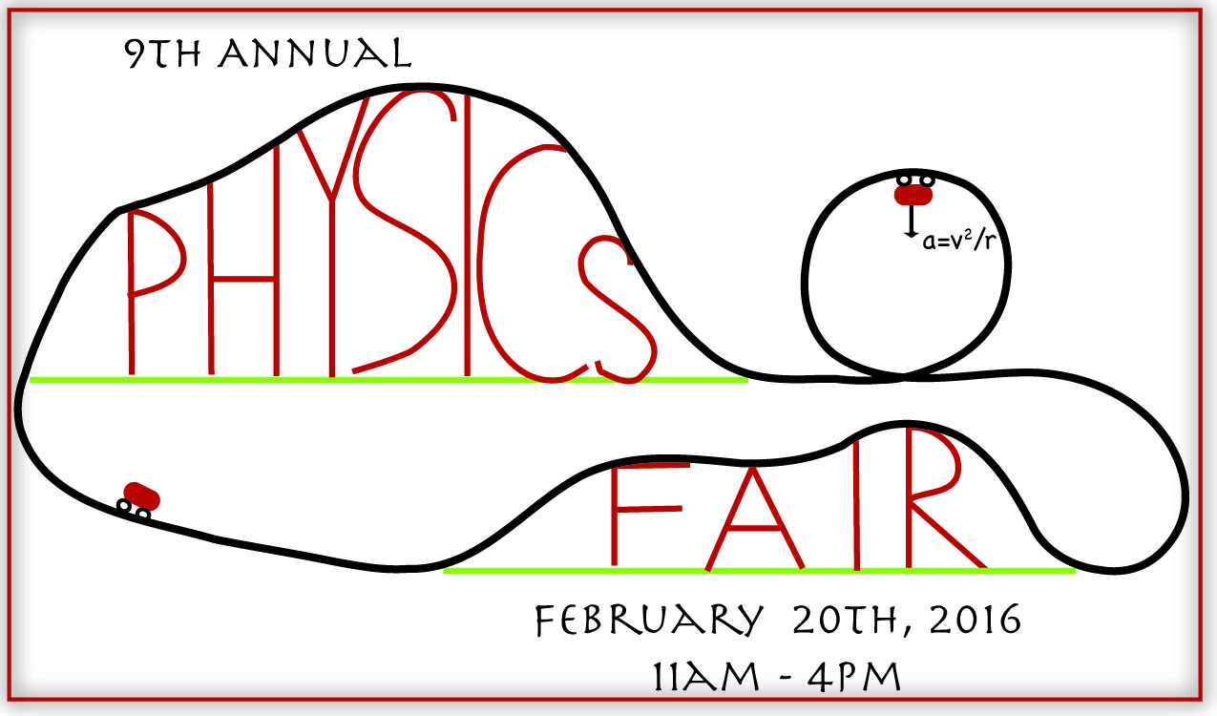
Don’t miss the Physics Fair!
Hands-on activities and lab tours
Meet scientists and students
Free and open to the public. No tickets required.
http://wonders.physics.wisc.edu/physics-fair.htm

Slide 5
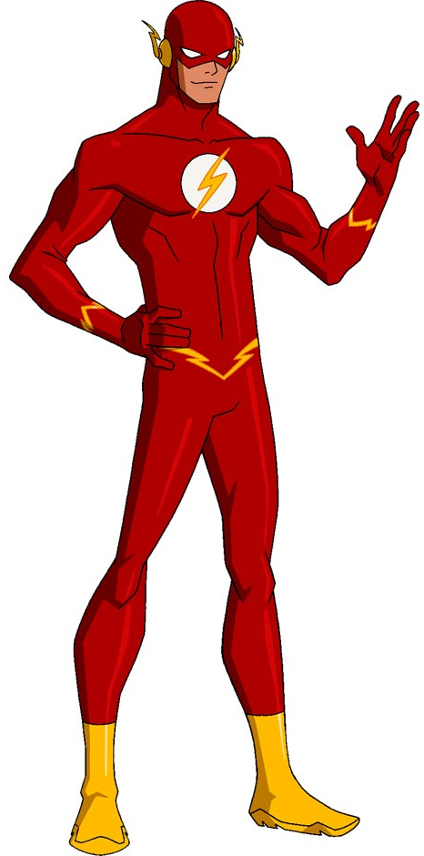
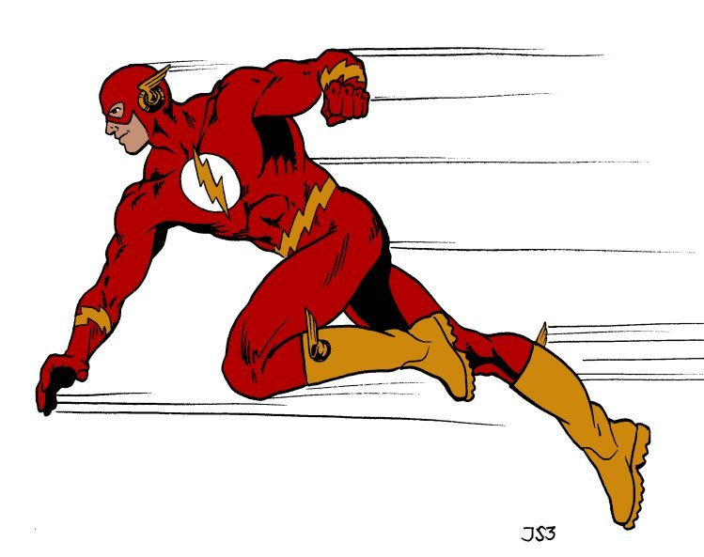
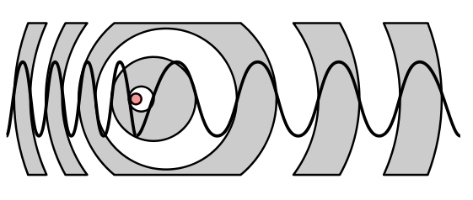
Super-Speed Sound Shift
The Flash hears a higher frequency when he runs toward the source of a sound. The faster he runs, the greater this shift in the frequency. This is known as the Doppler effect.
QUESTION: Flash hears a 166 cycles per second (Hz) sound. He knows the actual sound is 100 Hz. How fast is he running?
A) 50 mph B) 100 mph C) 300 mph D) 500 mph E) 1,000 mph

Slide 6

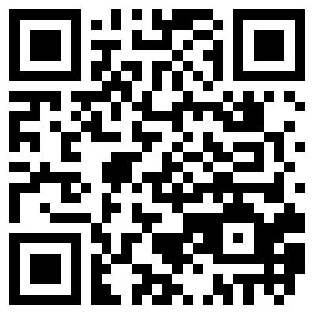
Donations are welcome!
Donations help us continue to present The Wonders of Physics year after year!
Donation bins are located outside of the lecture room
Donate online! Visit wonders.physics.wisc.edu
and click the Donate tab
Donations matched
through 2016!
Total matching
contribution: $15,000

Slide 7
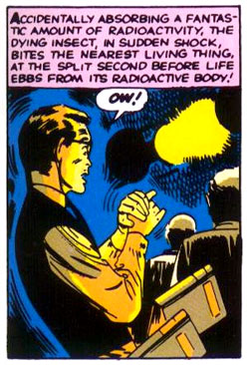
Spider Power
Peter Parker has been bitten by a radioactive spider, transforming him into Spider-Man!
THEORY: Spider-Man now has the same powers as a spider.
QUESTION: A spider can jump about 500
times its height. Peter is 6 ft. tall. How high can he jump now, with his “spider powers”?
A) 50 ft B) 500 ft C) 1,000 ft D) 3,000 ft E) 10,000 ft

Slide 8
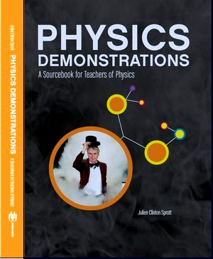
Physics Demonstrations: A Sourcebook for Teachers of Physics
Professor Clint Sprott’s book is a great resource for any science teacher
It contains detailed descriptions of 85 physics demonstrations used in The Wonders of Physics
Videos for the demonstrations are online at:
http://physicsdemonstrationsvideos.com/
It is available on amazon.com for $49.95

Slide 9
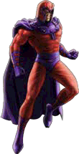
Magnetic Levitation
Super-villian Magneto has the power to generate and control magnetic fields.
THEORY: water weakly repels magnetic fields (diamagnetism), so Magneto could pick YOU up! (Water makes up about 60% of our bodies).
QUESTION: how strong would Magneto’s magnetic field need to be to pick you up? (In multiples of Earth’s magnetic field).
A) 2,000x B) 20,000x C) 200,000x D) 2,000,000x E) 10,000,000x

Slide 10
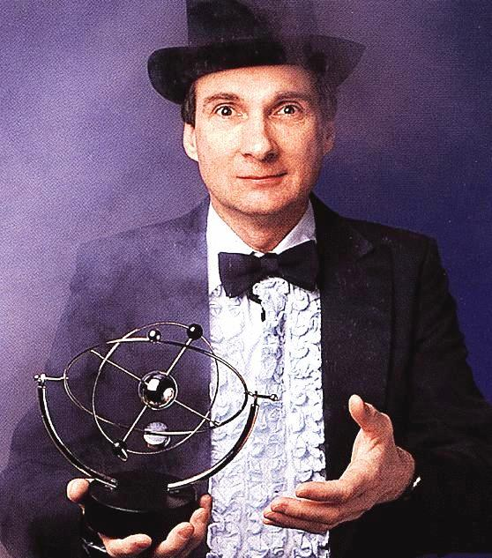
Professor Clint Sprott
Since 1984, Professor Sprott has presented The Wonders of Physics
He became a Professor of Physics at UW-Madison in 1973
His research is in plasma physics and chaos

Slide 11
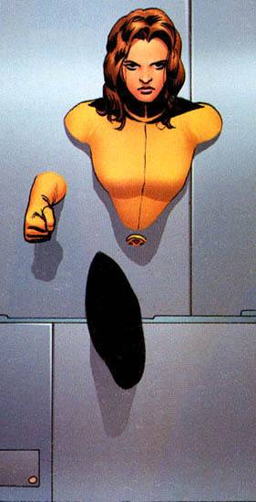
Walking Through Walls
Kitty Pryde of the X-Men can walk through walls!
THEORY: quantum physics says that objects CAN pass through other objects (quantum tunneling). But the odds of this happening are exponentially proportional to the mass of the object and the width of the barrier.
QUESTION: if Kitty had a mass of 50 kg, and
she ran as fast as she could at a wall, 1 million times a second, how many years would it take to pass through?
A) 1 B) 100 C) 1 million D) 1 billion E) >14 billion

Slide 12
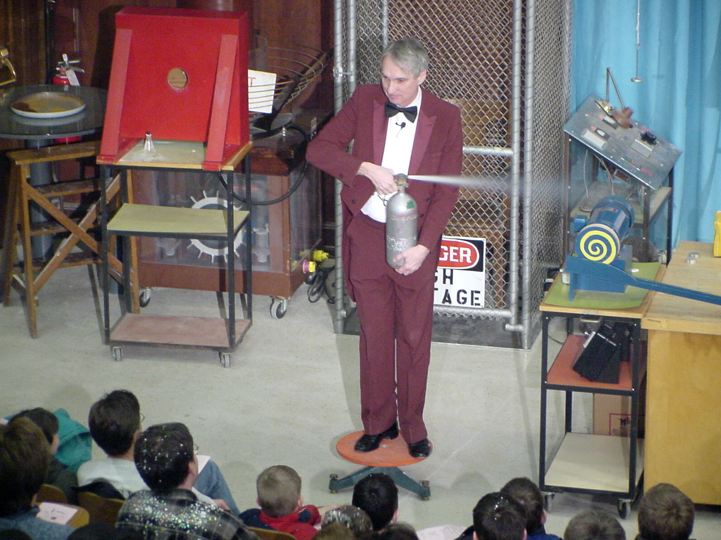
The Wonders of Physics shows are available on DVD and online!
Order any of the past 32 years of shows on DVD, or order the whole set!
Click the Gallery tab on our website to watch all of the past shows online
DVDs are available at the Wonders of Physics information table

Slide 13
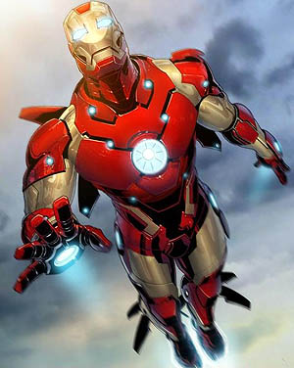
Iron Man
Tony Stark’s high-tech armored suit gives him a variety of super-powers, including strength, flight and weaponry.
QUESTION: about how much does the
armor in the suit weigh?
Assume the metal has the same density
as iron (8 g/cm³), the armor is 1/8 in. (0.32 cm) thick, and has a surface area of 26,200 cm². (1,000 g = 2.2 lbs).
A) 50 lbs B) 100 lbs C) 150 lbs D) 300 lbs E) 1,000 lbs

Slide 14
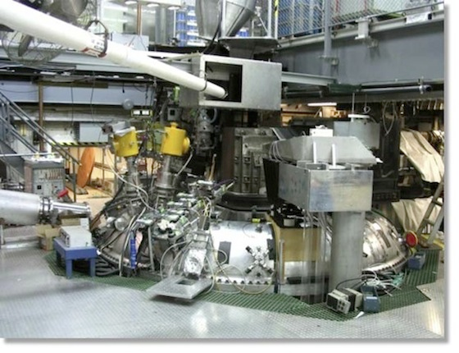
Madison Symmetric Torus
The Madison Symmetric Torus (MST) produces hot plasma for research in plasma physics and fusion power generation, the energy source of the sun.
Plasma is created when five giant capacitor banks dump 20 million watts of power in 1/10th of a second! That’s enough juice to light up a small town (very briefly).
Every time the MST fires, it makes a loud 'WOMP', scaring the heck out of unsuspecting students as they walk by!
The MST is located right here in Chamberlin Hall.
Visit http://plasma.physics.wisc.edu for more information.

Slide 15
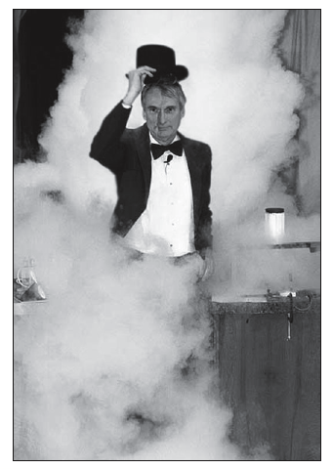
The 33nd year of
The Wonders of Physics!
The first Wonders of Physics shows were in 1984
The shows were inspired by UW Chemistry Professor Bassam Shakhashiri’s “Once Upon a Christmas Cheery” lectures
Through 2015, Professor Sprott and friends have presented 277 shows to 96,880 people!

Slide 16
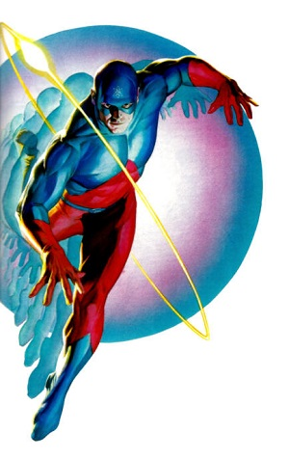
The Atom
Physics Professor Raymond Palmer, a.k.a. The Atom, can shrink and grow his body!
THEORY: Prof. Palmer got his super-powers by picking up a 12” dia. meteorite – a chunk from a white dwarf star.
QUESTION: how much would the white
dwarf star fragment weigh? (White dwarf stars are made of carbon and oxygen nuclei in a sea of electrons, packed as closely as they can be).
A) 100 lbs B) 1,000 lbs C) 10 tons D) 1,000 tons E) 50,000 tons

Slide 17
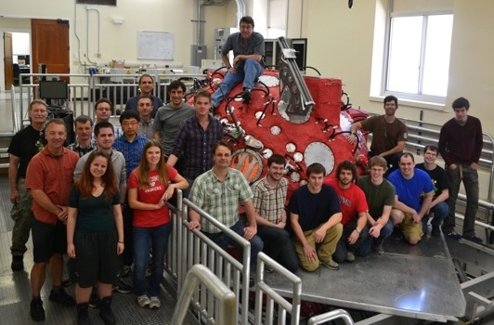
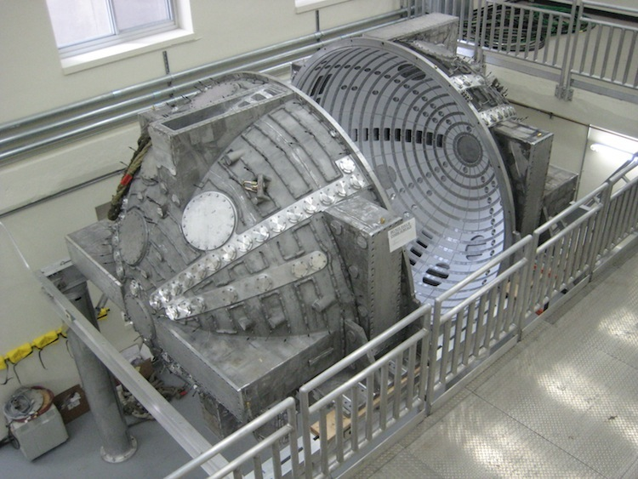
Madison Plasma Dynamo Experiment
A UW-Madison research project to simulate the superheated gases that form the sun's magnetic field.
The hollow aluminum sphere, built by four Wisconsin companies, weighs 11,000 pounds. It was built to heat gases to 500,000 degrees Fahrenheit.
It helps researchers understand why the sun occasionally spews out particles that affect the Earth, knocking out satellites and even taking down power grids!
The sphere occupies a two-story lab in Sterling Hall.
Visit http://plasma.physics.wisc.edu for more information.

Slide 18
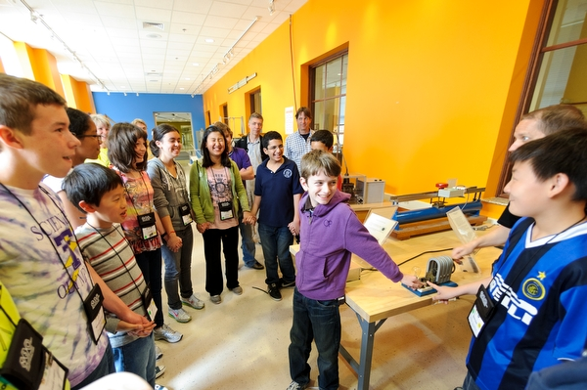
After the show…
Visit the Wonders of Physics information table and purchase a T-shirt, DVD or science toy!
Visit the Ingersoll Physics Museum

Slide 19
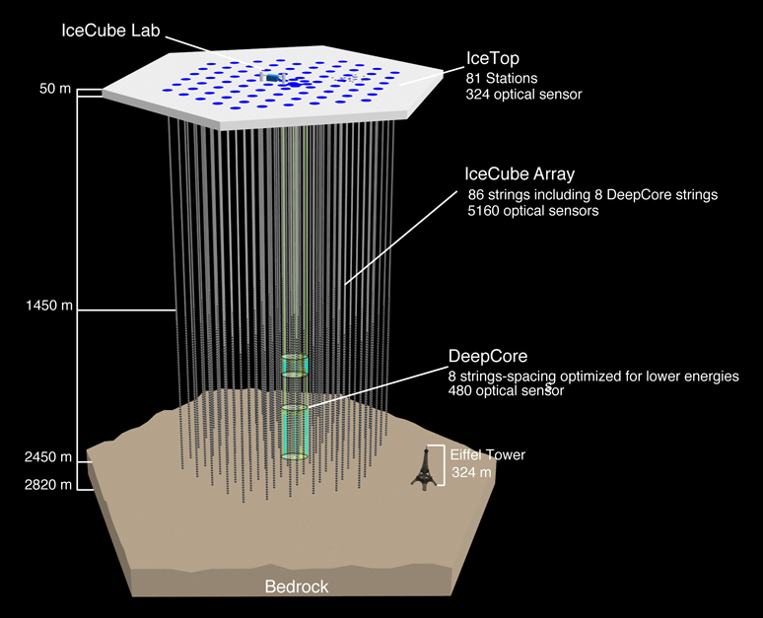
IceCube Neutrino Detector
A unique telescope at the South Pole! Most telescopes look at light; IceCube looks for mysterious particles called neutrinos.
Neutrinos come from the sun, cosmic rays, and exploding stars! Over 5,000 basketball-sized detectors were placed deep in the Antarctic ice. The detectors look for flashes of blue light given off when neutrinos hits atoms. The direction and intensity of the light can tell us where the neutrino came from in the Universe.
IceCube is the world's largest neutrino detector, encompassing a cubic kilometer of ice! Many of the detectors were built and tested at UW-Madison.
Visit http://www.icecube.wisc.edu/ for more information.

Slide 20

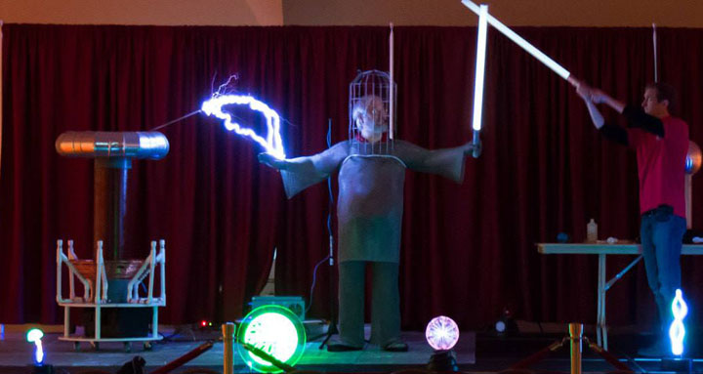
Don’t miss
Science Expeditions 2016!
April 1, 2 & 3, 2016
UW-Madison campus
Fun, family-friendly event for kids and adults of all ages
FREE!
Visit science.wisc.edu for schedule and more.

Slide 21


Funding Support
The Wonders of Physics program is made possible by grants from the Office of Fusion Energy Sciences of the United States Department of Energy and the National Science Foundation…

Slide 22
Funding Support
However, this funding is ending.

Slide 23
Funding Support
We need your help!

Slide 24
Funding Support
Please visit http://wonders.physics.wisc.edu and click the Donate tab to find out how you can make a difference!
Donations matched
through 2016!
Total matching
contribution: $15,000
Thank you!

Slide 25


Food for the Cast & Crew
Provided By

